Slide 1

Student Self-Assessment

Slide 2
Objectives
Review the ladder of feedback structure from the last COP meeting, as well as provide an opportunity to share out successes.
Deepen understanding of the purpose and value of student self-assessment and how it can be a guiding point for students taking accountability for their own learning.
Identify strategies for embedding self-assessment into daily formative assessment routines.
Review next steps and how to start small to make the largest impact.

Slide 3
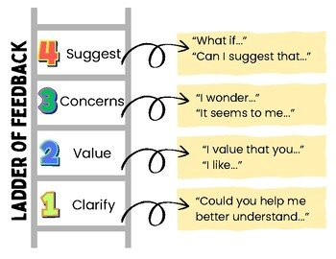
Recap for Feedback Loop
Notes:
Throw in Cowboy stick figure drawing for recap

Slide 4
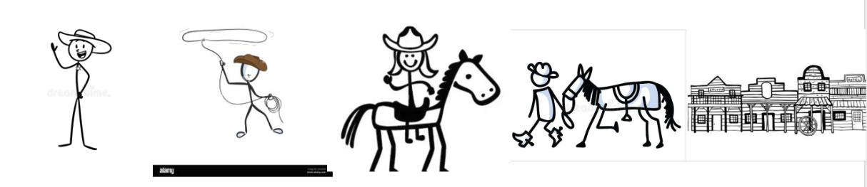

Slide 5

Share out on Ladder of Feedback Implementation

Slide 6
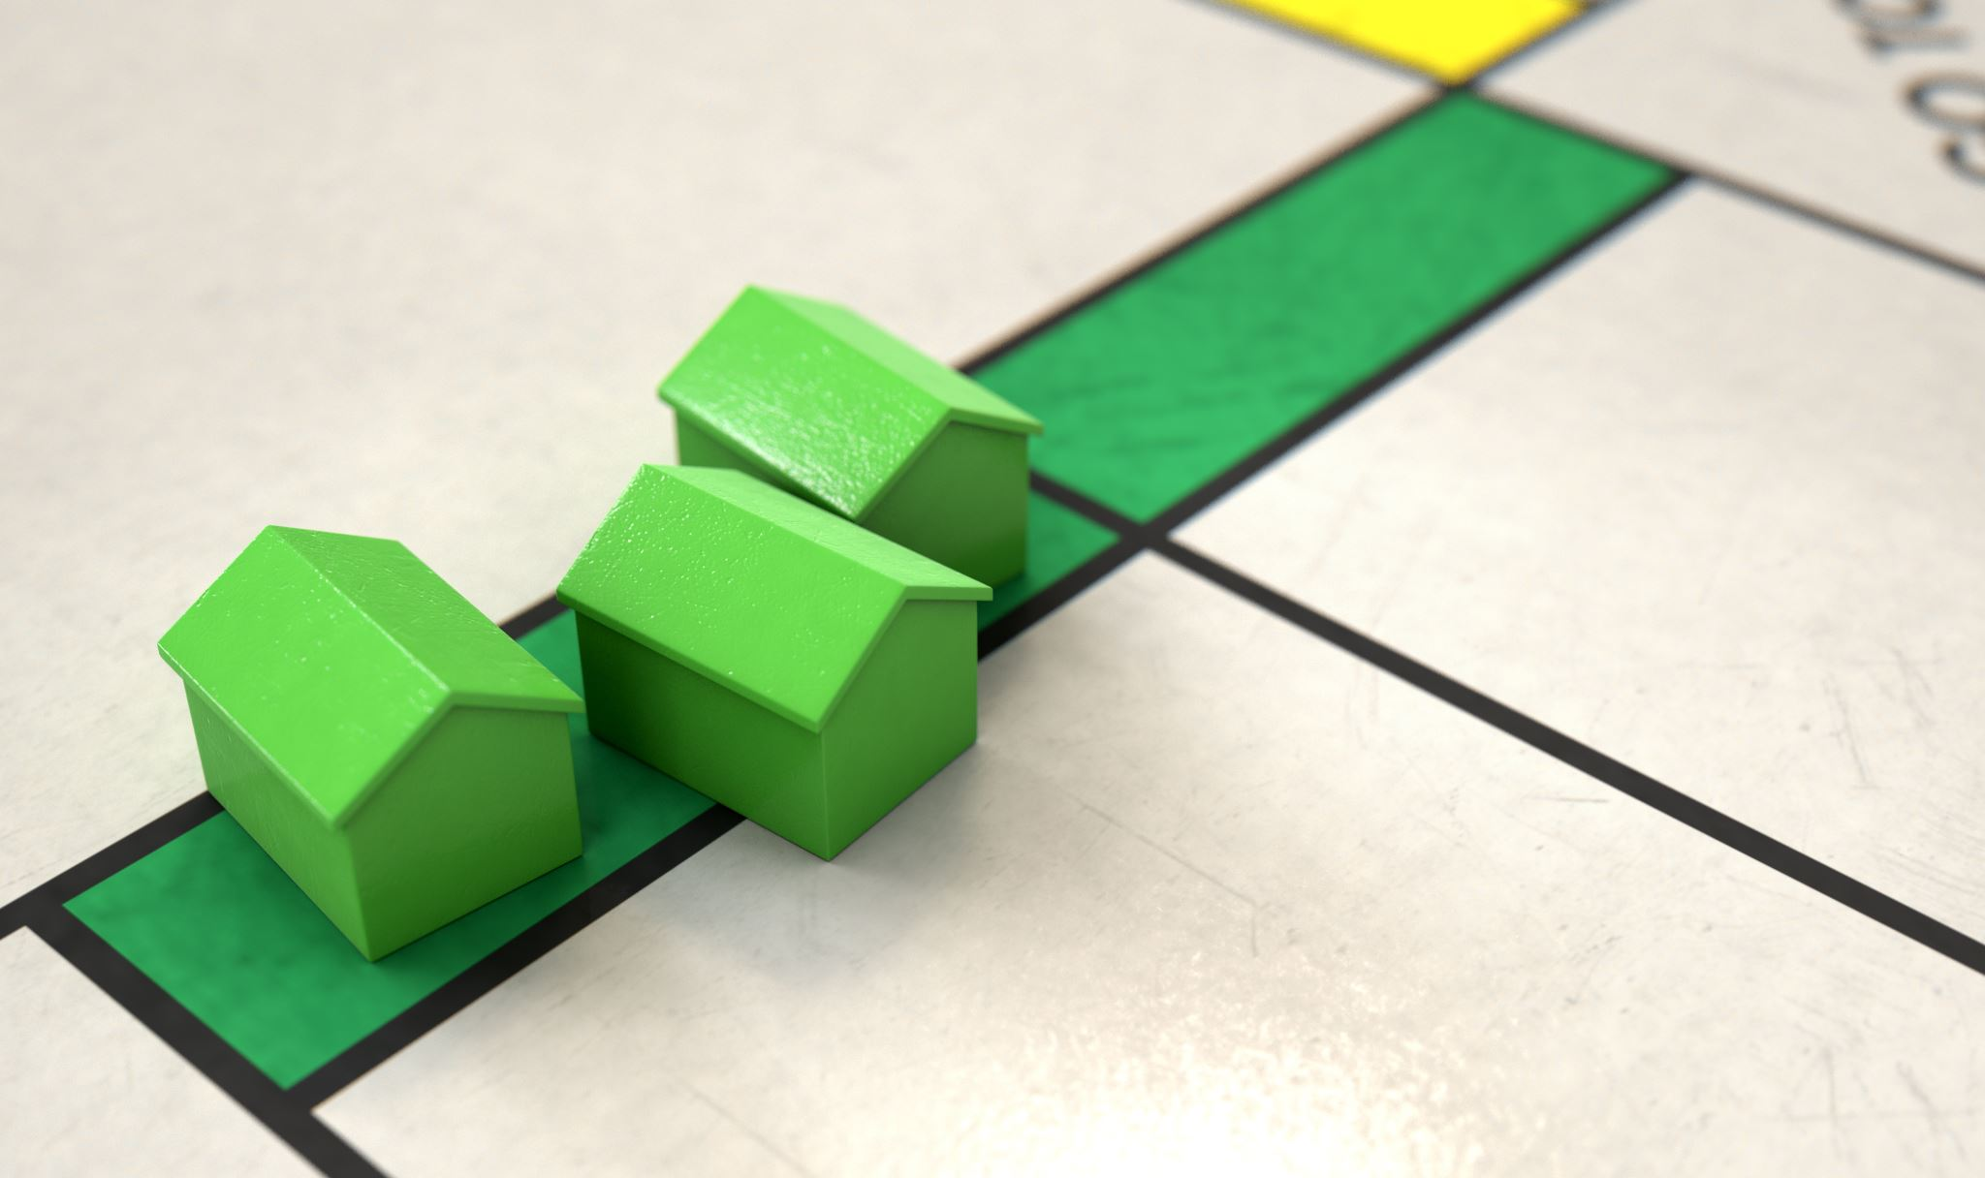
The Goal...build efficacy through assessment
Notes:
Think of your own journey towards self efficiacy. How do you get there and build your confidence? We are all human.

Slide 7
Self-Efficacy
Individual's belief in their capacity to organize and execute the actions required to achieve specific performance outcomes.
Increased self-efficacy grows motivation.
Built through mastery moments.

Slide 8
Assessment vs. Evaluation
Assessment
Evaluation
To improve learning and progress
Formative and ongoing
Diagnostic, learner-centered
To judge the effectiveness or outcomes.
Summative and conclusive
Judgmental, criteria-based.

Slide 9
Self-Assessment Continuum
Learning Intention ✅
Success Criteria ✅
Descriptive Feedback 🤔
Peer or Self-Assessment ½✅
Setting Individual Learning Goals
Revision of Assessment or Learning Task
Notes:
Loop back to descriptive feedback – don't remember how indepth we went at CACTE.

Slide 10
Principles of Good Feedback...
It clarifies what good performance is (goals, criteria, expected standards).
It facilitates the development of self-assessment in learning.
It provides high quality information to students about their learning.
It encourages teacher and peer dialogue around learning.
It encourages positive motivational believes and self-esteem.
It provides opportunities to close the gaps between current and desired performance.
It provides information to teachers that can be used to help shape teaching.

Slide 11
Assessment Capable Learners ask
Where am I at?
Where am I going?
What is the goal?
How am I going to get there?
Qualities of Assessment Capable learners:
+ Self-Responsibility
+ Meeting challenges and new opportunities
+ Knowing the next step
+ Learning strategies (application)
+ Explaining learning progressions
+ Questioning and inquiry
+ Collaboration
+ Motivated
+honor effort & continuous improvement
+ Ownership
Notes:
Ability for students/learners to reflect/assess assessments to improve learning and growth. Engaged and willing to take risk. Goal-oriented (importance of standard)
Many students were not trained to be assessment-capable learners; some will learn the skill faster than others. Many times that student who digs their heels in hasn't had great success in the past, they need someone to believe in them, talk them through situations, celebrate small wins and more.

Slide 12
Implementation Strategies

Slide 13
Activity 1
Notes:
Ocean topography with school of fish

Slide 14
Learning Target: Draw a Colorado Mountain Meadow
I can describe and illustrate the key features of a Colorado mountain meadow in a simple drawing.
Notes:
Success Critiera – how do we know we have successfully drawn a cowboy?
Image of a person
2-3 characteristics of a cowboy (hat, boots, horse, spurs, rope, mustache, saddle, etc)
Advanced – multiple characteristics/landscape

Slide 15
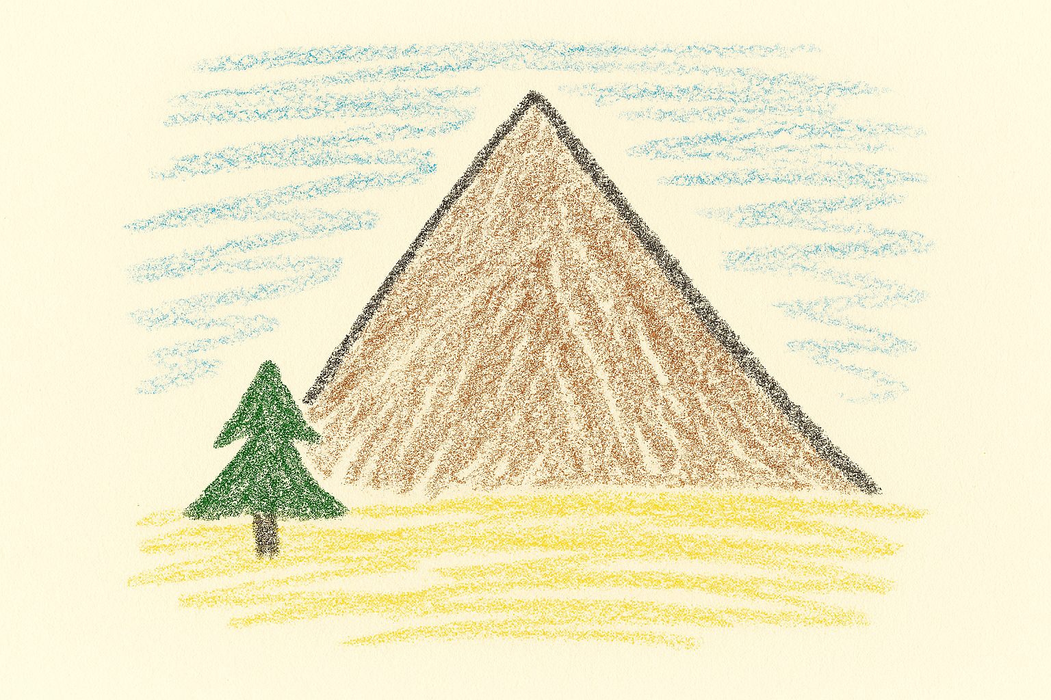

Slide 16
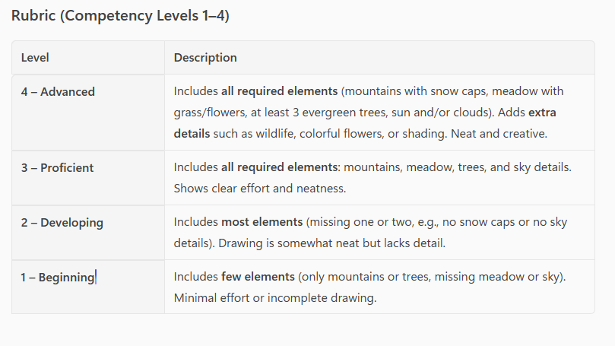
Success Criteria
My drawing includes:
  Mountains (with snow caps)
  Meadow (grass or flowers)
  Trees (evergreens typical of Colorado)
  Sky details (sun and/or clouds)
My drawing is neat and shows effort.
My drawing uses 3 colors

Slide 17


Slide 18


Slide 19
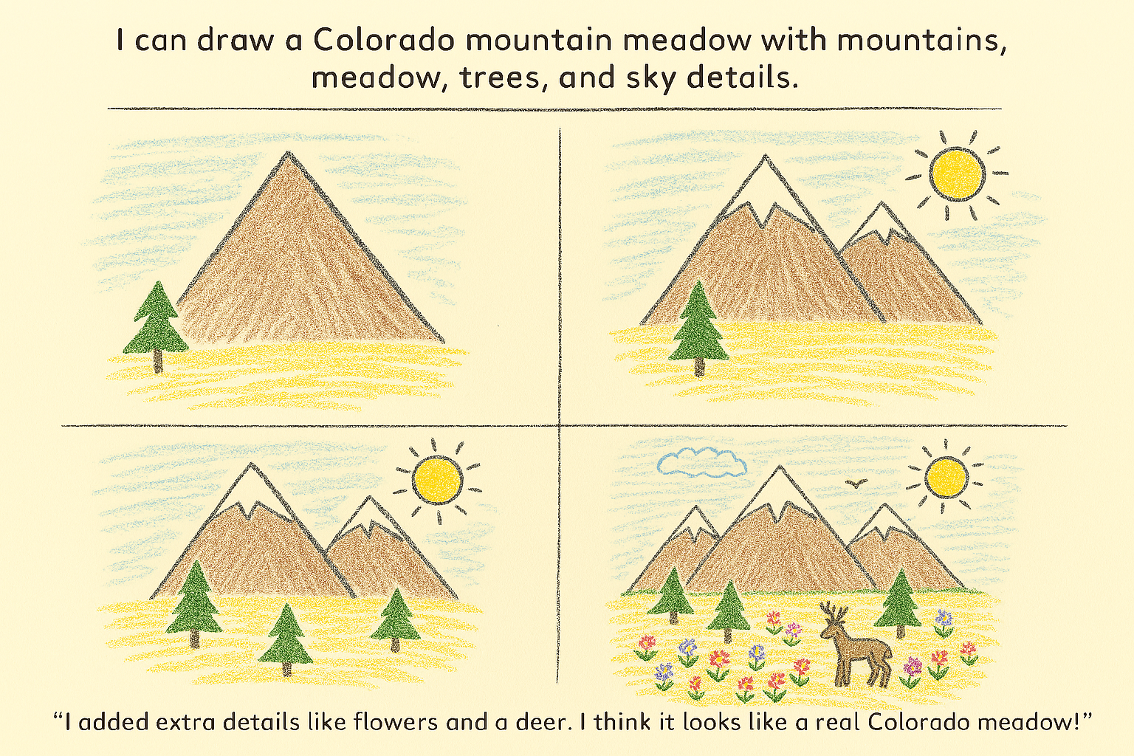
Portfolios
Allows students to see progression of learning.
Captures historical feedback.
  Highlights potential repetition of challenges.
Showcases growth and success.
Tangible to track and assess.

Slide 20
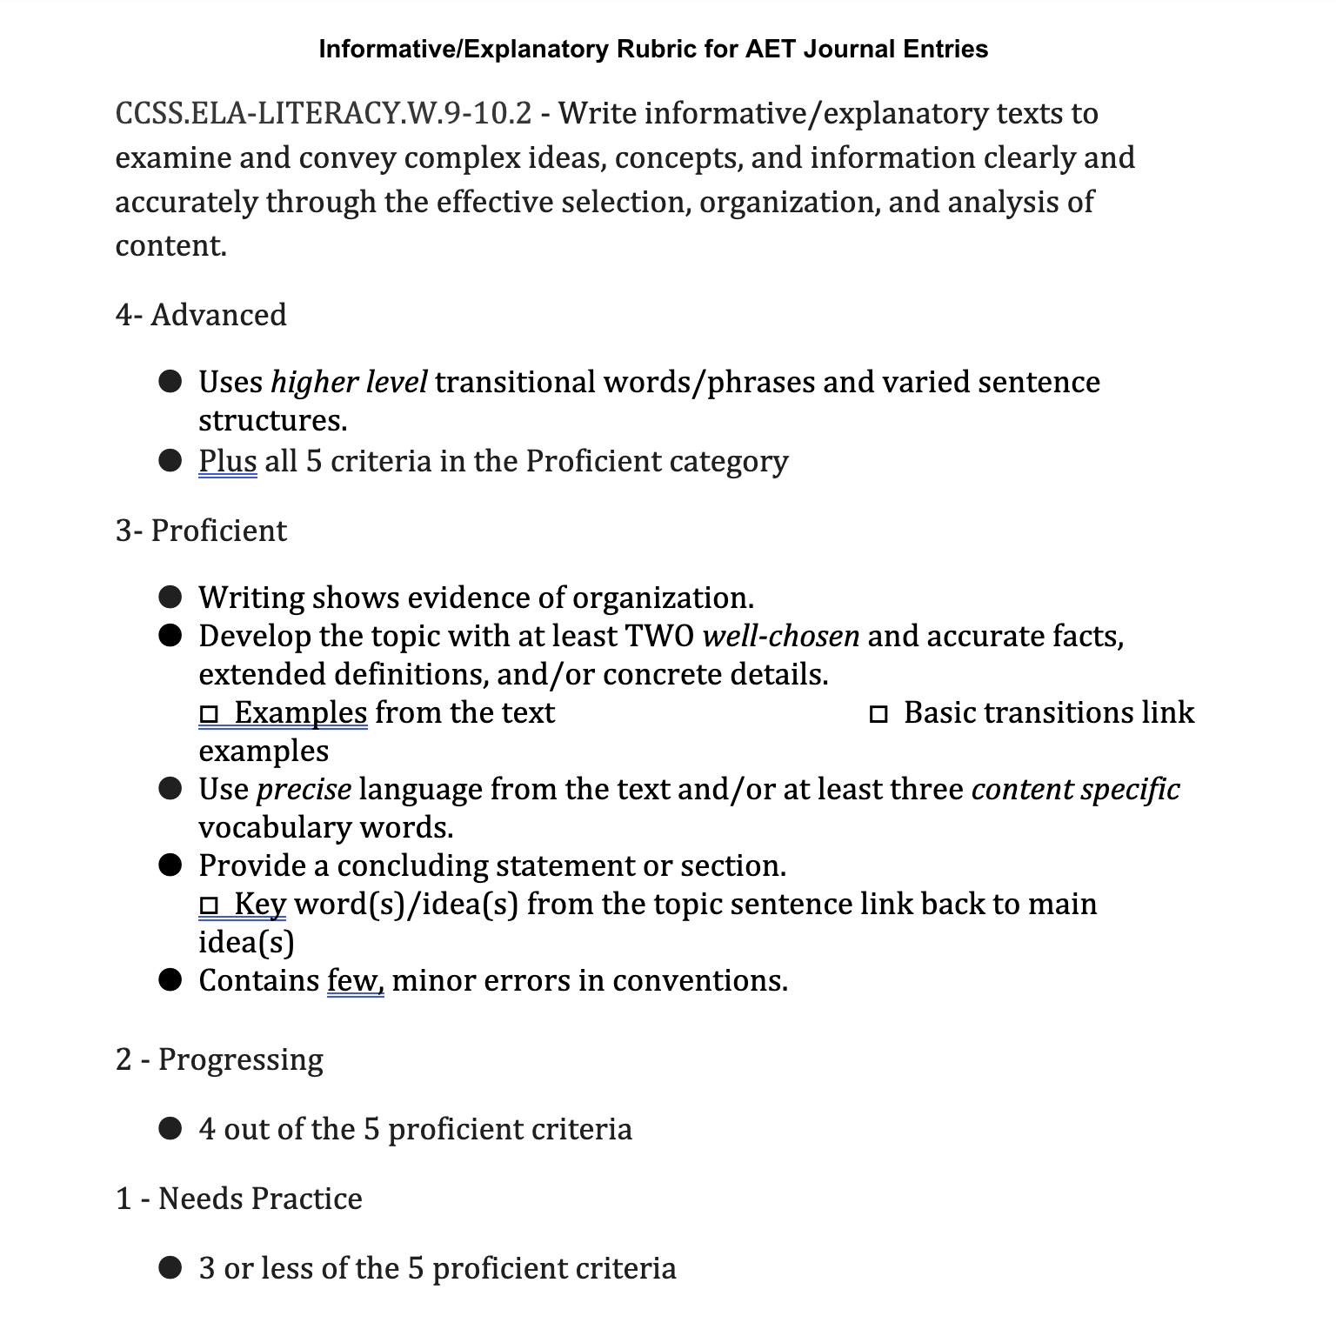
Rubric Reflection
Red= Stop, I am confused.
Yellow = I am not sure about this. I am confused
Green = I can keep going, I understand
Notes:
Self Reflection prior to work,
Gap identification
Goal setting

Slide 21
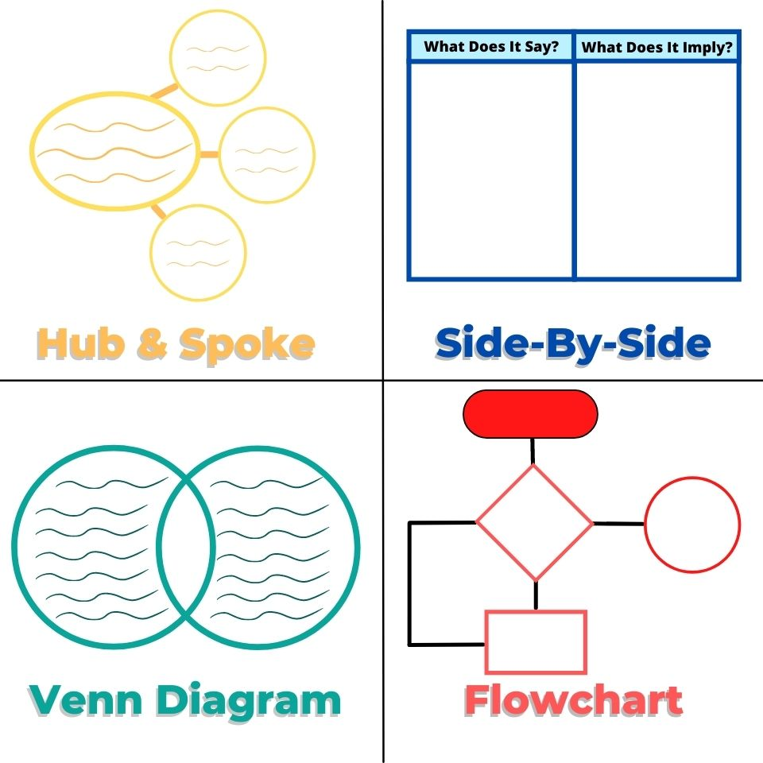
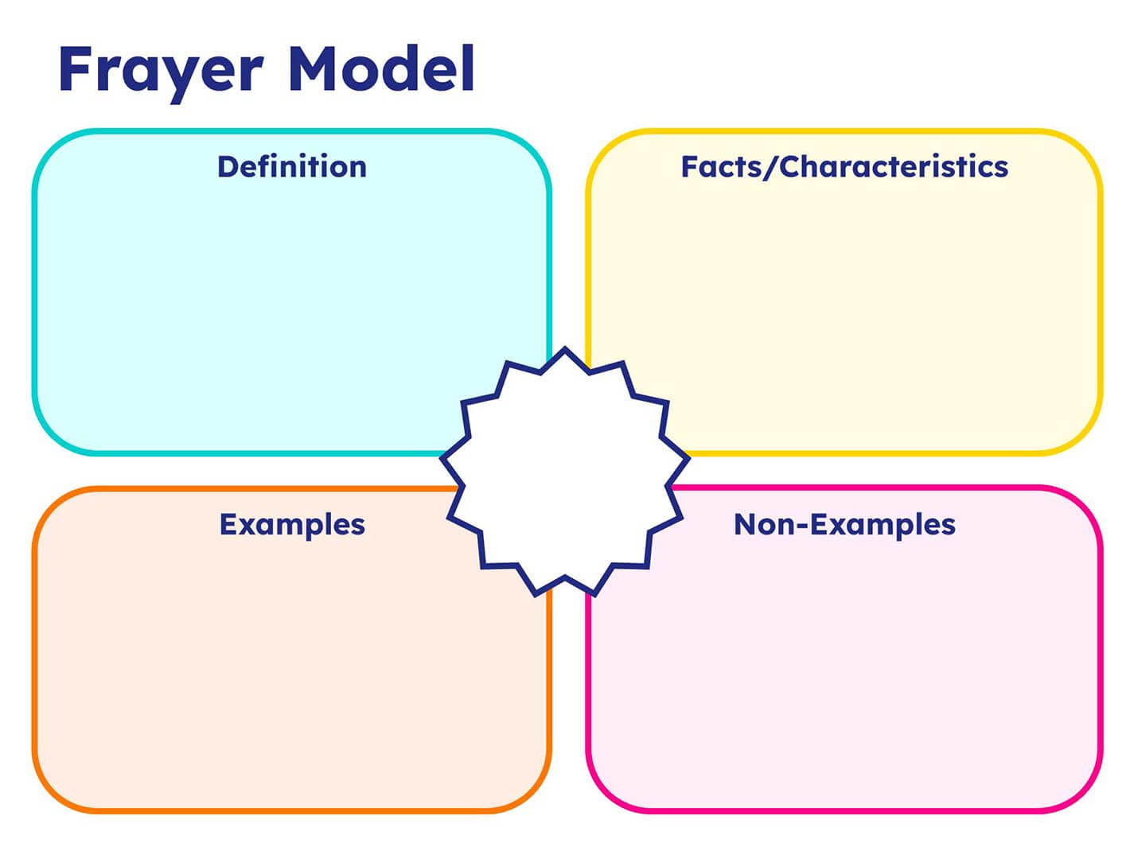
Graphic Organizer
Makes thinking visible
Should be paired with success criteria
  Identification of gaps that should be addressed

Slide 22
Benefits for students
Increase skill of student adjusting what they are doing to improve quality.
Increase responsibility for students to own their learning.
Positive effect on low achievers
Development and refinement of critical thinking
Increase mathematics problem solving ability
Improved academic results in narrative writing
Reduction in disruptive behavior.

Slide 23

Next Steps
Start small, choose one class to implement
Practice with a colleague
Practice, Practice, Practice
Be repetitive
Build the culture of understanding and growth
Failure is inevitable, learn from it.
Can you team up with another teacher to have a consistent thought partner?
  Build the impact team.
  How can AI help after a student masters self-assessment?

Slide 24
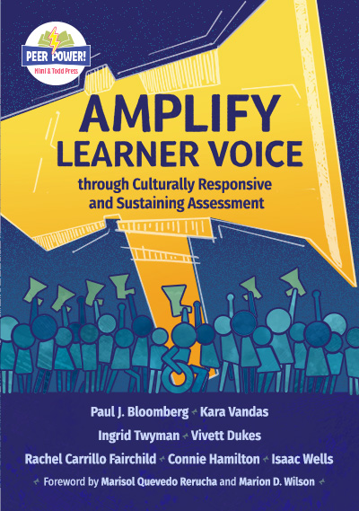
Resources
Assessing Learning: The Students at the Center Series
Three Tools for Engaging Students in Self-Assessment
Support Strategies for Learner Self-Assessment
Notes:
https://www.jff.org/idea/assessing-learning-student-center-series/
https://thecorecollaborative.com/three-tools-for-engaging-students-in-self-assessment/
https://learnercentered.org/strategies/support-learner-self-assessment/

Slide 25
Upcoming Communities of Practice
Goal – Setting February 4th
End of Year Share-out - April 8th

