Slide 1

Goal-Setting

Slide 2
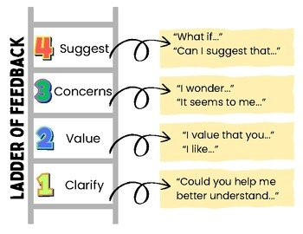
Recap for Feedback Loop

Slide 3

Share out on Ladder of Feedback Implementation

Slide 4

Reflect on your goal setting journey
Notes:
What was successful
What wasn't
How did you build "buy-in" for the goals?
How did you build capacity to take charge of your own professional or personal learning?
BEST way to promote self efficiacy

Slide 5
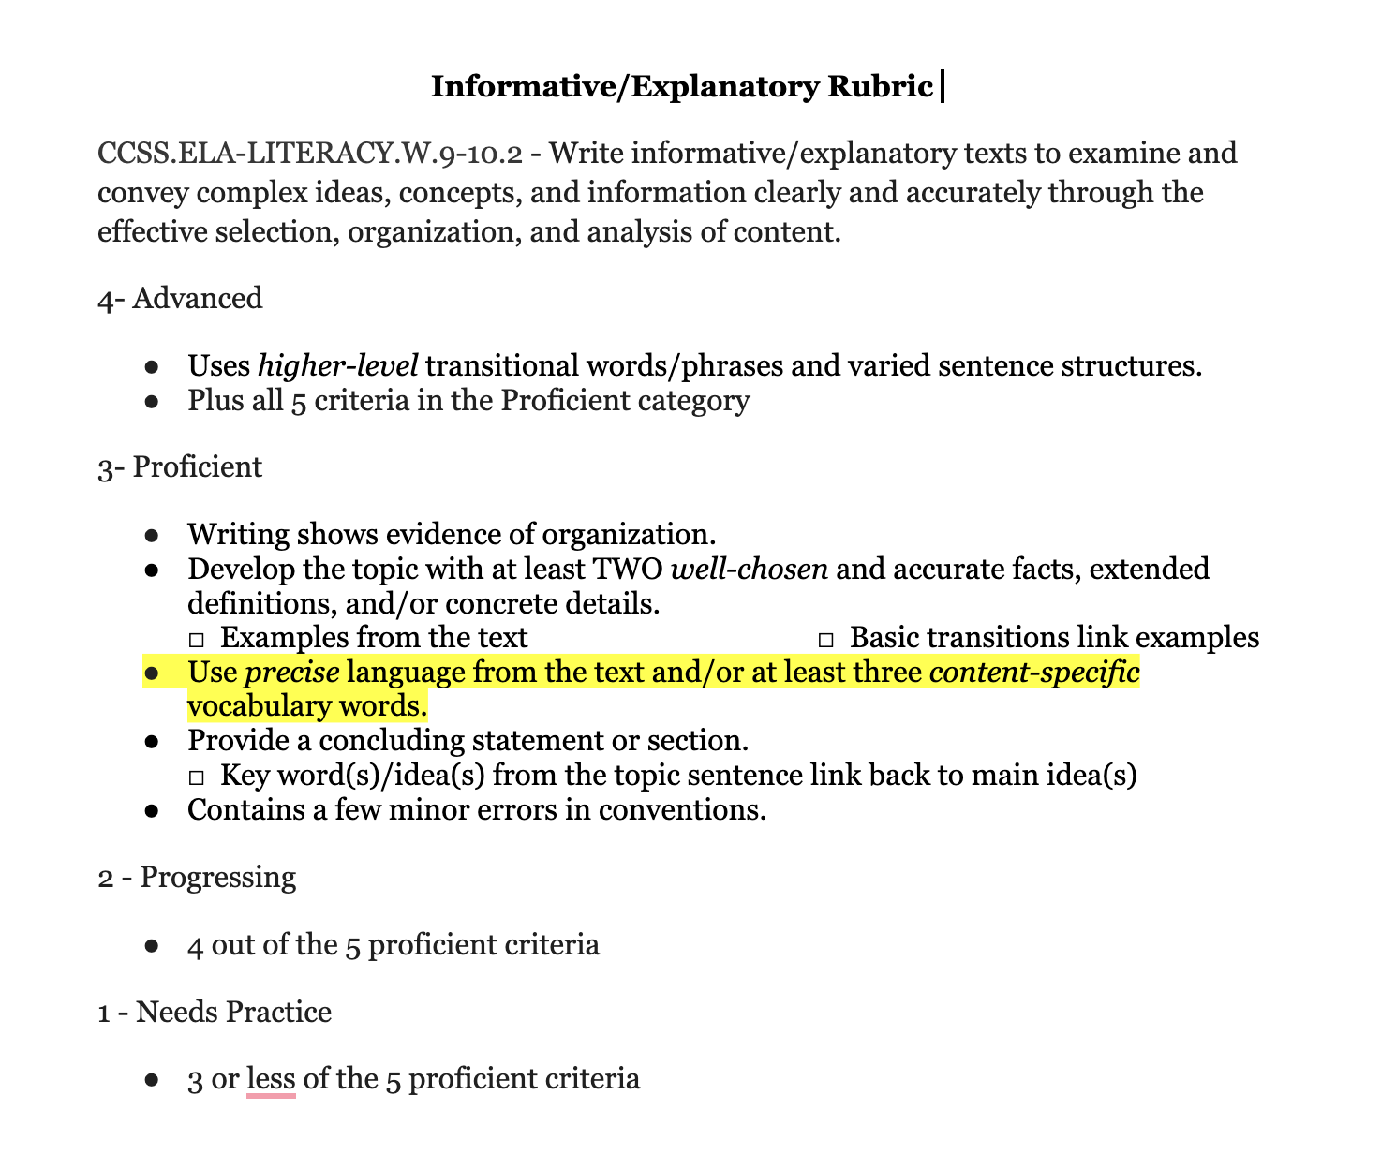
Goal-Setting
Set learning goals after feedback is received from a self-assessment, peer ladder of feedback, or teacher developed formative assessment.
Use success criteria for the creation of the goal.
Highlight the specific target students need additional support in.

Slide 6
S.M.A.R.T Goals
S – Specific
M – Measurable
A – Attainable/Action-Oriented
R – Relevant
T – Timely/Track the Learning

Slide 7
Goal-Setting Basics
Know the starting and ending points.
  Scaffold along the way.
  Make goals small and attainable in the beginning.
Build a class culture of understanding and growth.
  Failure is part of success.
Keep students goals private.
Celebrate the failures and successes.

Slide 8
Benefits for Students
Achieving goals are a measure of success towards mastery of standards.
Specific goals lead to a high level of performance.
Achieving goals improve self-efficacy.
Students utilize metacognition, higher-order thinking skills when setting goals.
Goal-setting allows for self-regulation, the learner's adjustment in the learning process in their response to their perception of feedback.
Notes:
Metacognition - the awareness and self-regulation of one's own cognitive processes, involving planning, monitoring, and evaluating learning to improve performance

Slide 9
Steps to setting Goals
Self-Reflection
  Self/peer feedback
  Feedback on feedback from the teacher
Identify specific goals
Connect goals to learning activities
  How can we help students make connection to future careers?
  Build a portfolio or work to show progress and mastery
Reflect and revise
Celebrate successes

Slide 10
Implementation Strategies
Leverage a goal-setting template.
I do, we do, you do modeling procedure
Start small
Build in consistent check-points for the goal during the formative assessment process.
Teach students how to be reflective and give them a space to fearlessly reflect.

Slide 11
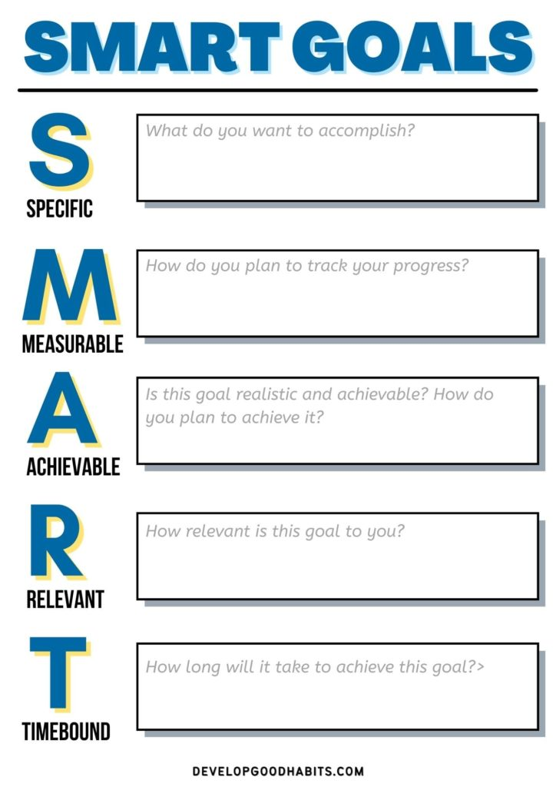
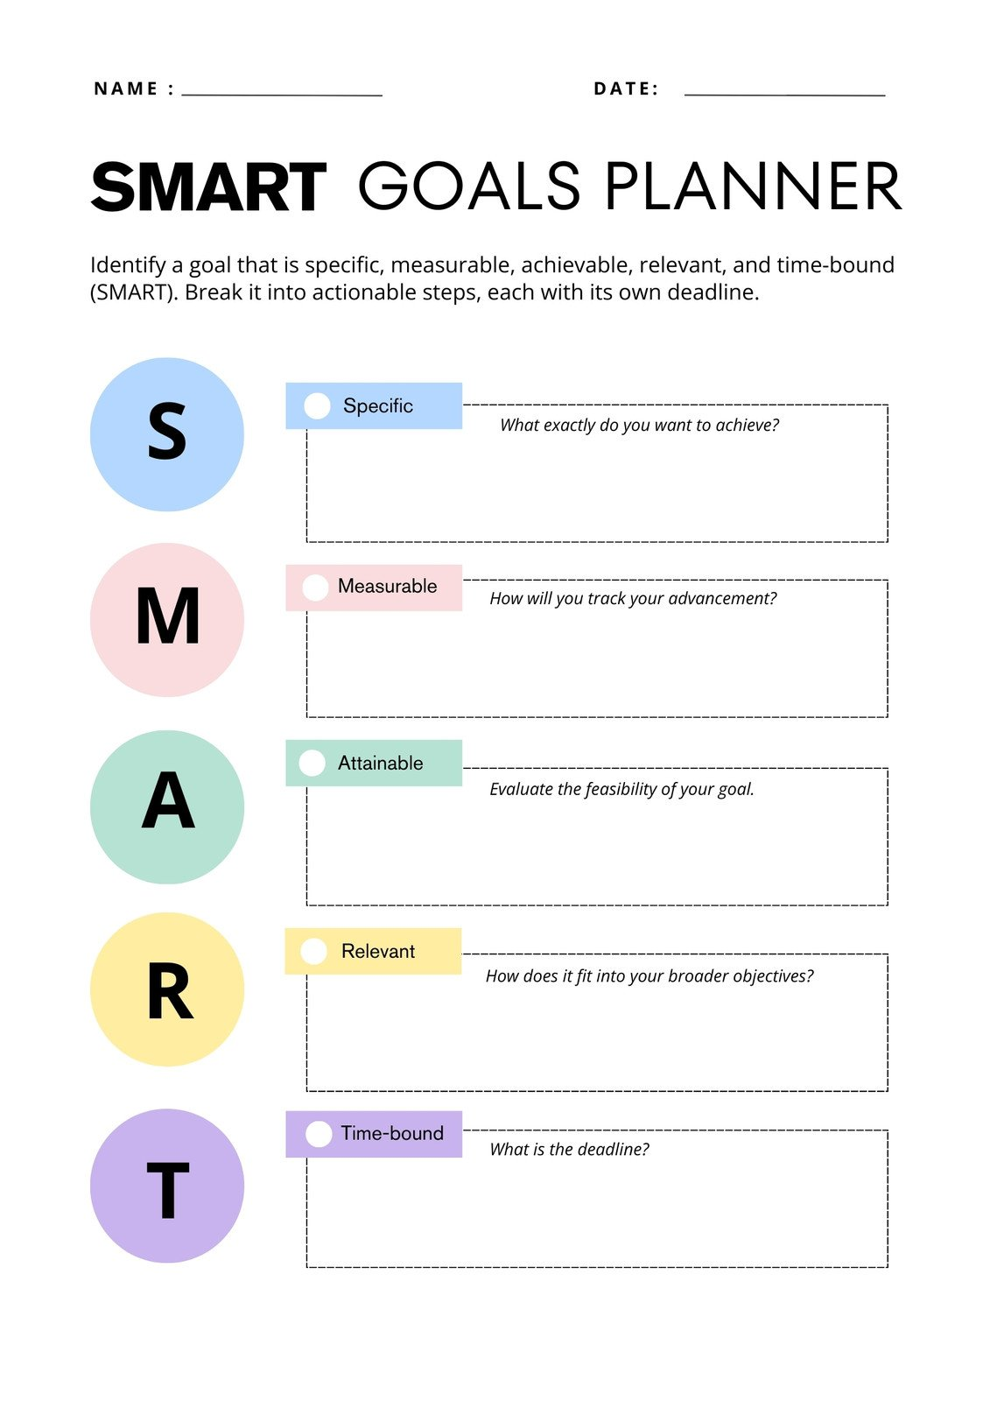
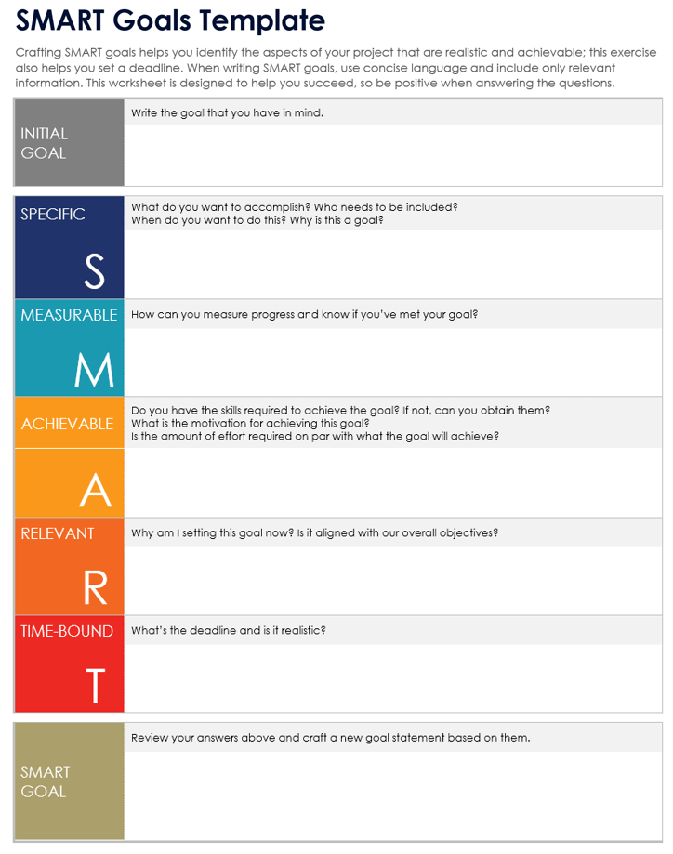
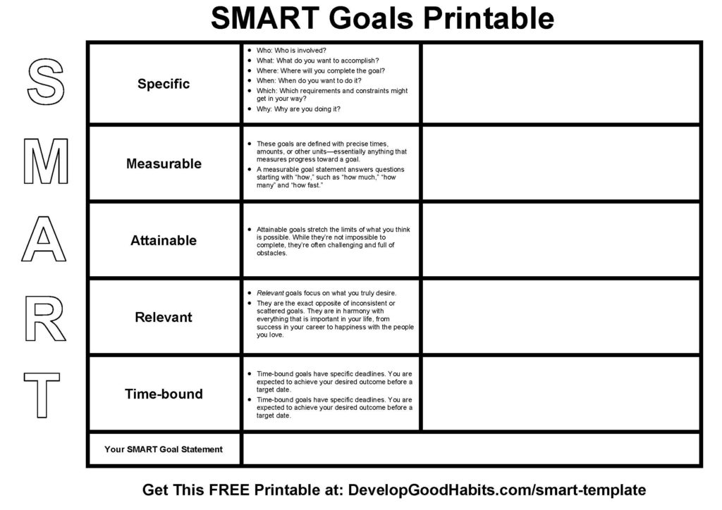
Templates

Slide 12
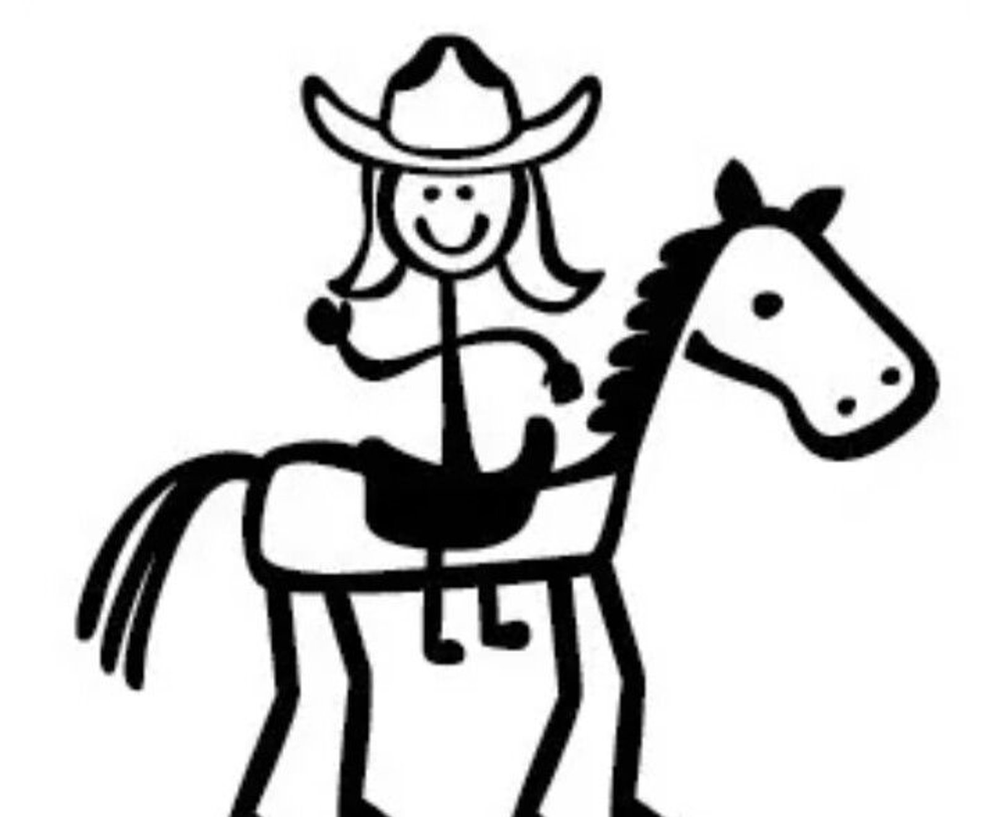
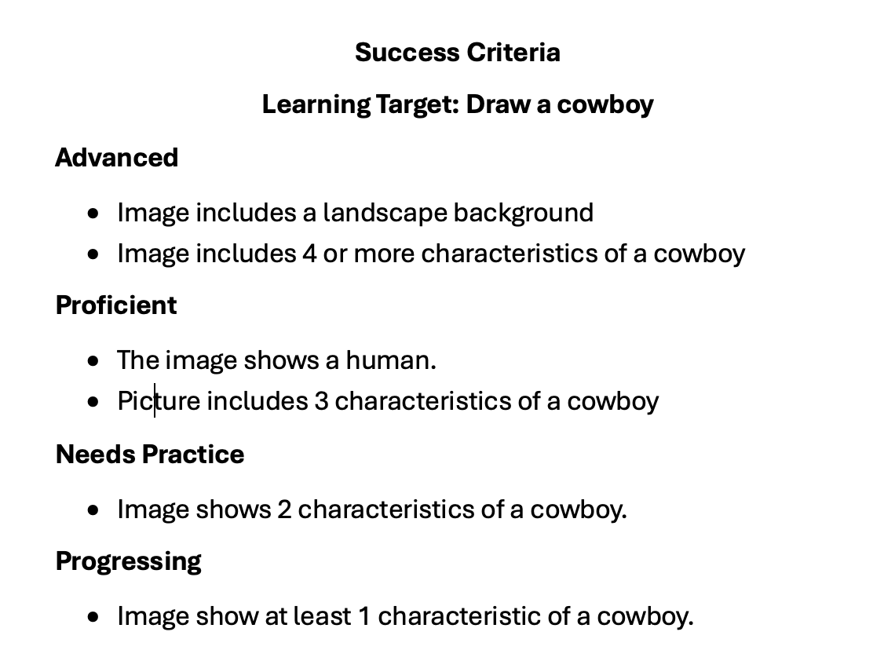
Example
Notes:
Based on the success criteria and image, what would be a goal that could be developed?
Is there more capacity building needed as far as understanding the components of a specific character or landscape?
Is time a factor? Did the student rush and needs to make a goal on time management?

Slide 13
Provide Exemplars
What would be exemplars for each S-M-A-R-T look like?
Specific
Measurable
Attainable
Relevant
Timeline

Slide 14
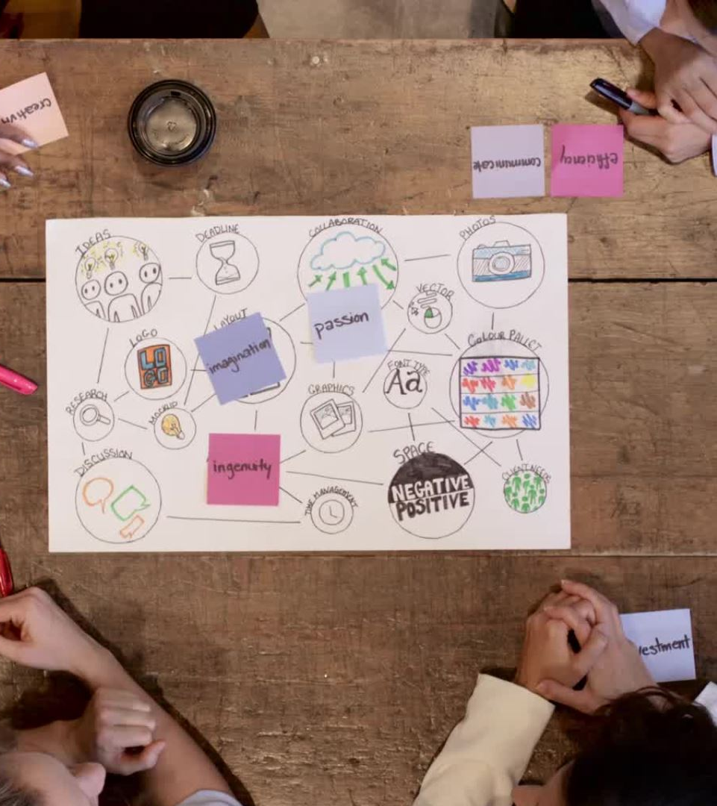
Tiered Supports (MTSS)
1 – Needs Practice
  Students leverage graphic organizers to tracking their thinking (turned in with assessment
  Check points with the teacher to "talk" through thoughts before progressing
2 – Progressing
  Students leverage graphic organizer to track their thinking.
3 – Proficient
  Students leverage success criteria as a checklist
4 – Advanced
  Students review and include higher-level standards, highlighting their implementation

Slide 15
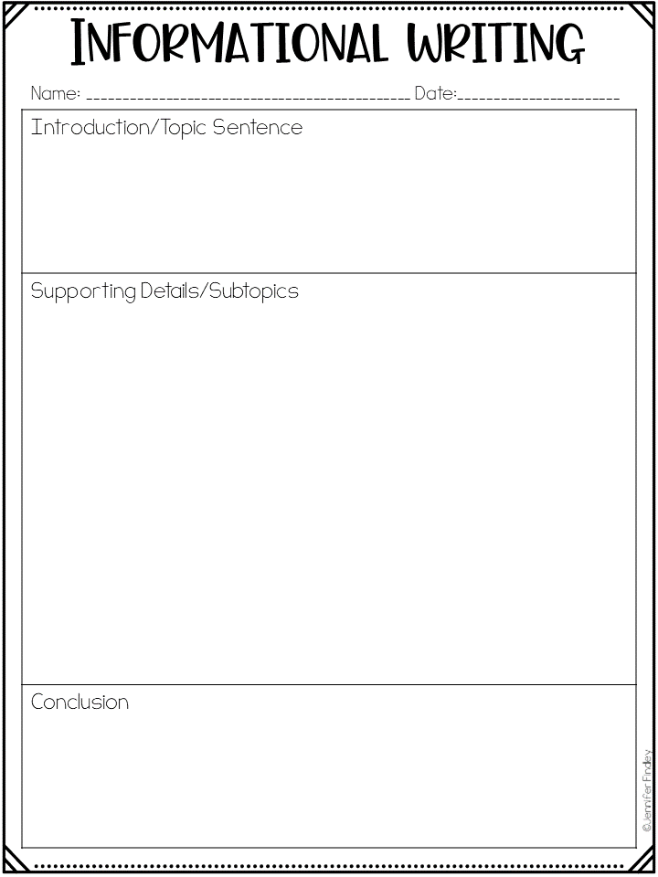
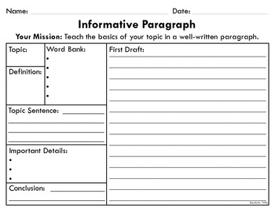
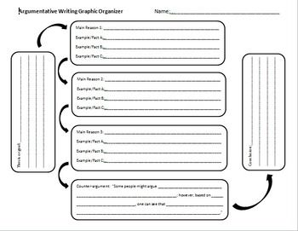
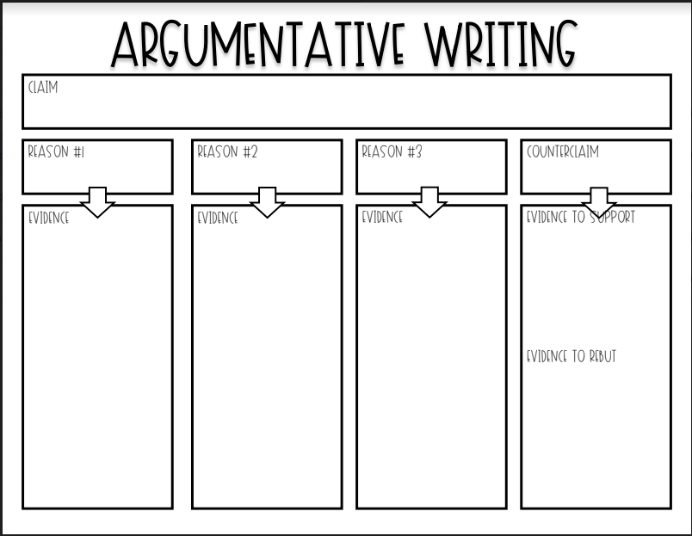
Support Strategies for Goals

Slide 16

Your Turn: Create your goal
Notes:
Create a goal for implementation of one of the ELA success critiera
What are the specific steps?
Who do you need to collaborate with?
What would Tier 1, 2, and 3 scaffolding look like in your classroom to support advanced, proficient, progressing, and needs practice students?

Slide 17
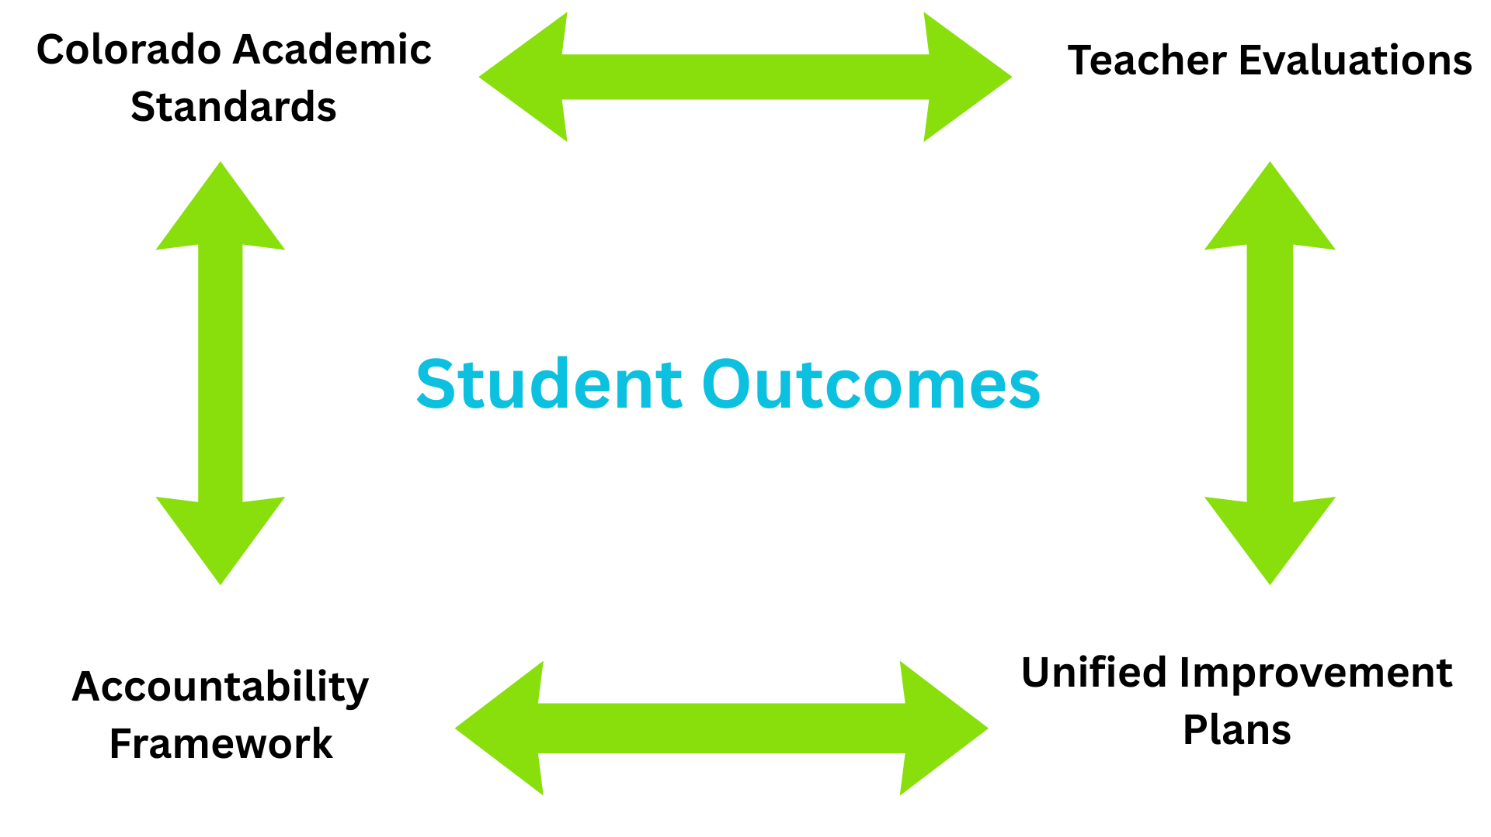

Slide 18
Share-out
What's your plan to implement components of the formative assessment process?
Any "Ah-Ha" moments?

Slide 19
What's next?
Math Academic Integration Workshop at CACTE
  Availability of Success Criteria
  New and old standard development
  Formative Assessment practices
Video recordings through shared online platform
Program Director implementation through Scope and Sequence documents

Slide 20

Thanks for joining us!

