Slide 1

Feedback Ladder
Formative Assessment - Community of Practice
Notes:
HIT Record – share out in November newsletter

Slide 2
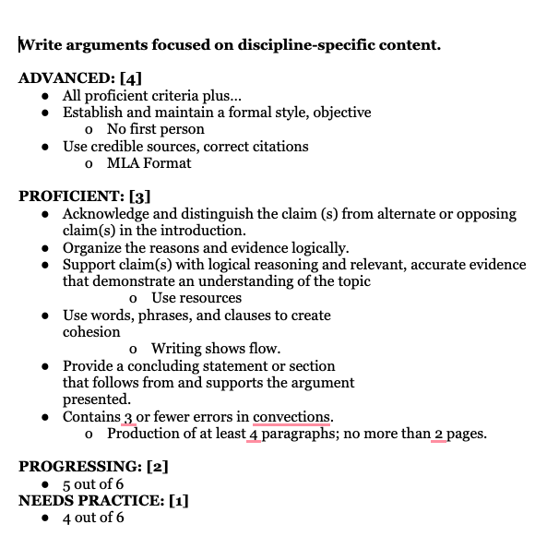
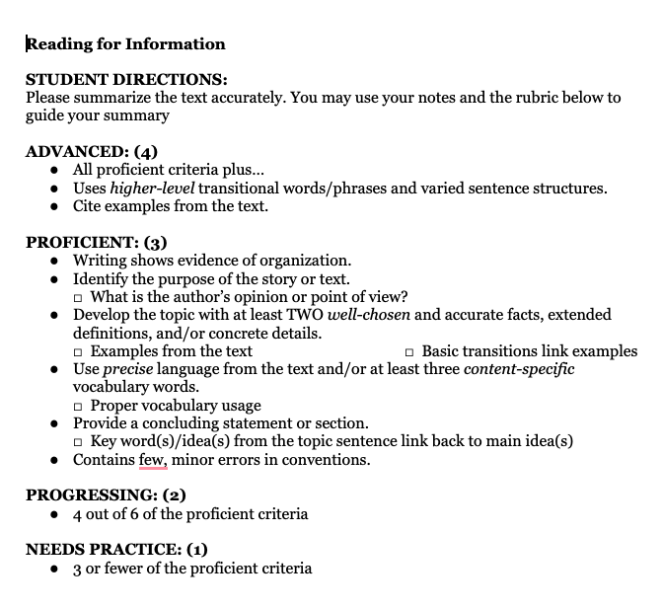
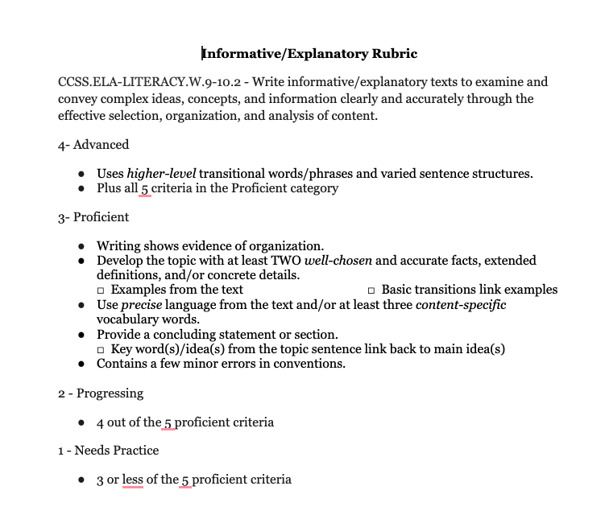
CACTE Recap – ELA Success Criteria

Slide 3

The Why?
CTE programs must teach both technical skills and rigorous academics.
Build real-world skills: Communication, problem-solving, and connections
Connect academics to careers: Apply learning to authentic career experiences
Support Perkins law goals: Ensure students gain career-ready skills and equitable access to high-quality CTE programs.
Boost engagement and student success.
Notes:
Written into Perkins Law
Performance Metric Indicator
Just great teaching.

Slide 4
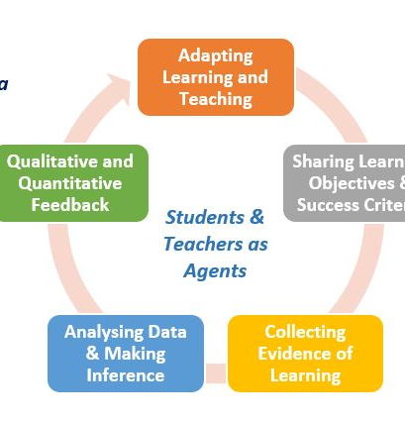
Formative Assessment Basics
Learning Target: What the student is expected to learn or be able to do.
Success Criteria: How students and teachers know the learning target has been met.
Feedback Loop: Ongoing communication between teacher and student about progress.
Self-Evaluation: Students reflect on their own work and learning.
Goal-Setting: Students set specific, actionable goals based on feedback and self-reflection.
Peer Feedback Encourages collaboration and multiple perspectives on what quality work looks like.
Notes:
Feedback loop, self-evaluation, goal-setting, and peer feedback will be provided in virtual communities of practice sessions over the 2025-2026 school year.
Include students in EVERY section, from developing the learning target and success criteria to building effective peer feedback and constructive criticism.
Think, I do, we do, you do theory
Connection with PWR standards throughout this process.

Slide 5

Learning Targets
A learning target describes - using words, pictures, actions, or some combination of the three – exactly what students are going to learn in today’s lesson, what they will be expected to demonstrate, and how well they are expected to learn and do it.

Slide 6
Success Criteria
Describes what successful (“on target”) learning looks like, identifies how the teacher and student will know when the learning goal has been met.
A way for the teacher and the student to know they are successful.
Student self-evaluation opportunities

Slide 7
Putting them together
🎯 Learning Target: I can identify the new Career Cluster Areas.
✅ Success Criteria:
  I can name all six Career Cluster Areas
  I can identify specific subclusters in each area.
  I can connect the Career Cluster Areas to specific career fields.
  I can explain the role of interdisciplinary clusters.

Slide 8

Share-out
How has it been working or not working?
What obstacles have you hit?
What successes have you seen?
Notes:
Reminders -
Start with only one class
Make the students help construct the learning target and success criteria if needed
Use examples they can relate to – including their language

Slide 9

Next Step.....
Ladder of Feedback

Slide 10
Feedback
Formative assessment is ALL about Feedback!
Seven Principles of Good Feedback
It clarifies what good performance is (goals, criteria, expected standards).
It facilitates the development of self-assessment in learning.
It provides high quality information to students about their learning.
It encourages teachers and peer dialogue around learning.
It encourages positive motivational belief and self-esteem.
It provides opportunities to close the gap between current and desired performance.
It provides information to teachers that can be used to help shape learning.

Slide 11
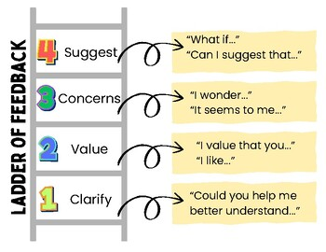
Ladder of Feedback

Slide 12
Modeling Examples
Classroom culture will set the expectation of feedback.
Root the expectation is classroom rules and norms.
You must model the behavior, questions, and tone that you want your students to use.
Frame curiosity and understanding
Leverage simple examples to start and then build up quality to ensure they see the broader picture of expectation.
Practice, Practice, Practice
Notes:
Classroom culture is key, if feedback is part of the class norm, everyone is here to learn then the implementation of the Ladder of Feedback will go smoothly
As in success critiera, students need to KNOW the expectation and be SHOWN the expectation. They should be the keepers of their own learning and be TAUGHT how to assess quality.

Slide 13
Modeling Exercise
Four examples
Use the questions from the Ladder of Feedback?
Capture the questions in the chat or on a notebook page to share out.
30-45 seconds per example
Notes:
Example is going to feel pretty elementary, but sometimes that is how you have to start to get the point across.
The examples are going to merge learning target, success criteria, and feedbackloops
Learning target: Draw a cowboy
Success Critiera – how do we know we have successfully drawn a cowboy?
Image of a person
2-3 characteristics of a cowboy (hat, boots, horse, spurs, rope, mustache, saddle, etc)
Advanced – multiple characteristics/landscape.

Slide 14
Learning Target: Draw a stick figure cowboy.
Success Critiera:
Notes:
Success Critiera – how do we know we have successfully drawn a cowboy?
Image of a person
2-3 characteristics of a cowboy (hat, boots, horse, spurs, rope, mustache, saddle, etc)
Advanced – multiple characteristics/landscape

Slide 15
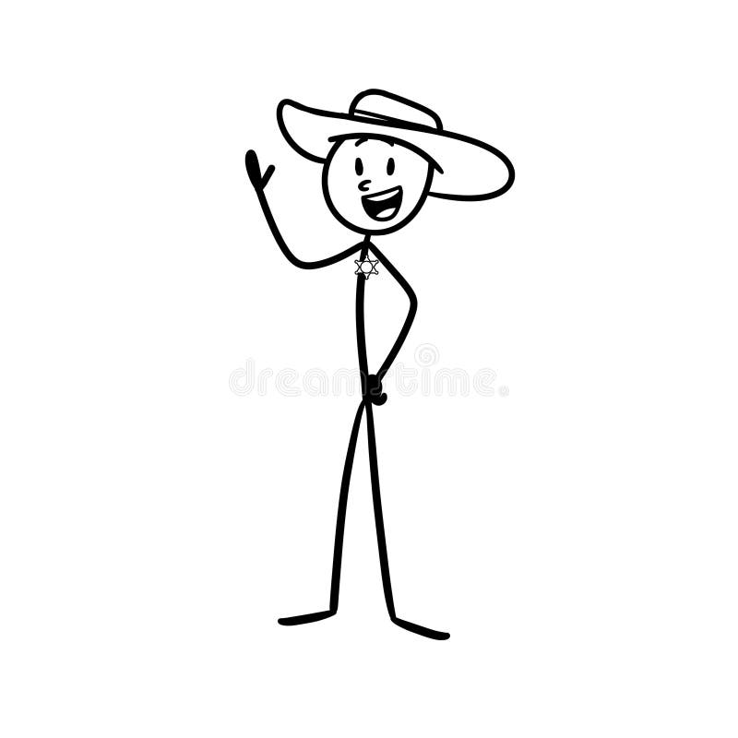

Slide 16
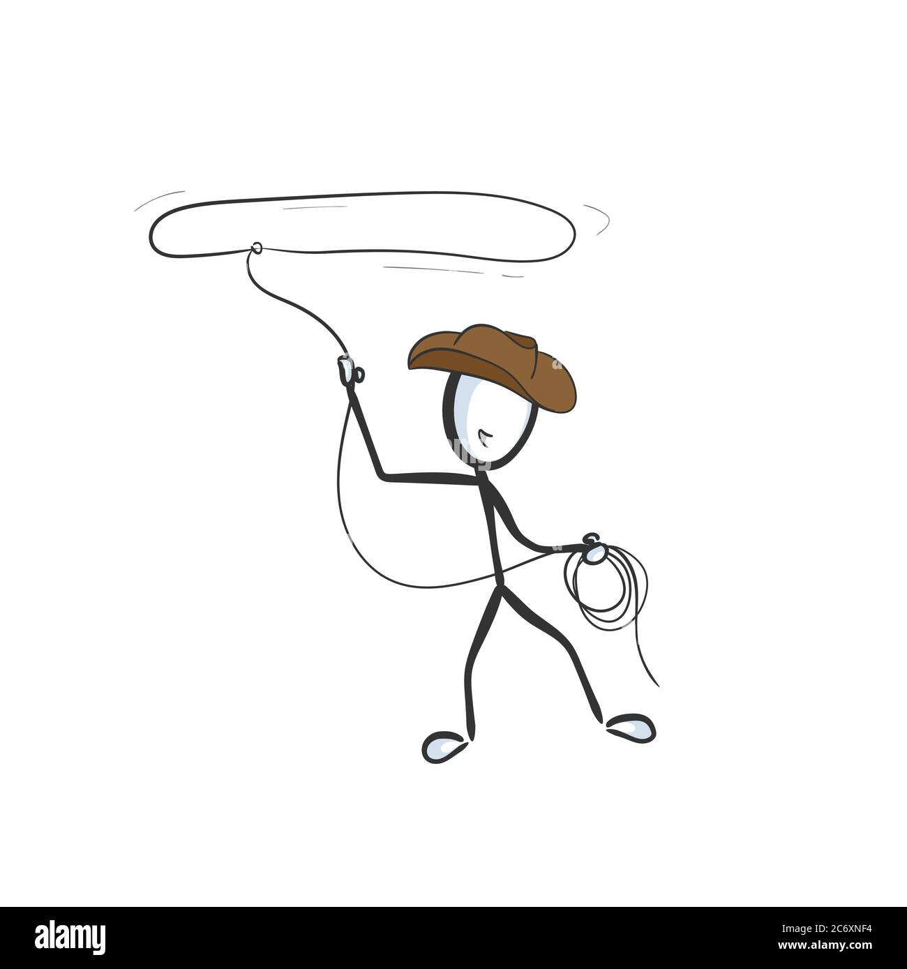

Slide 17
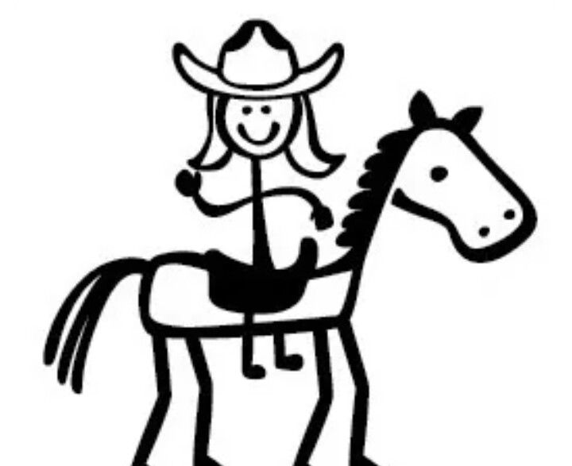

Slide 18

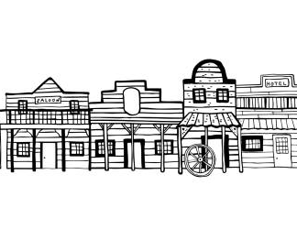

Slide 19
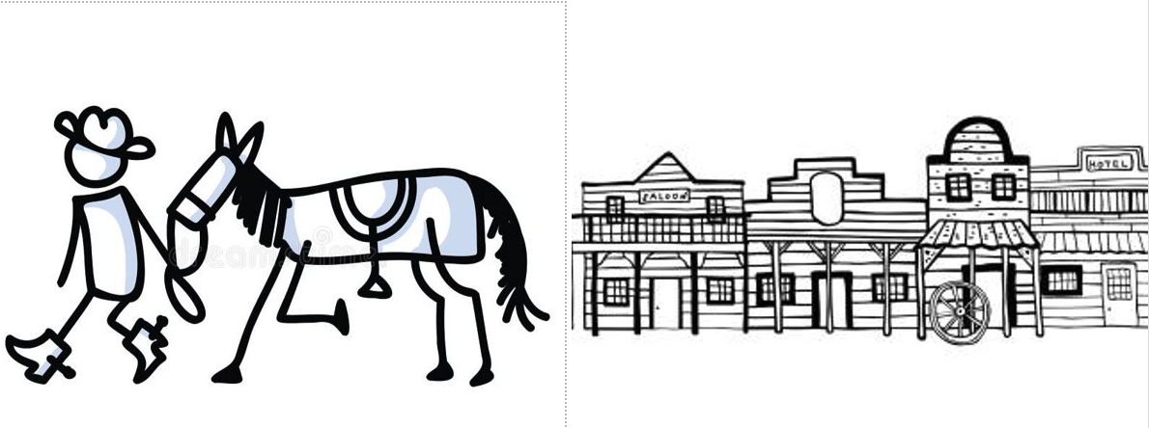
Reflection
How did your feedback questions change based on the increased quality of the image?
Who met the success criteria? What image went above and beyond?
Notes:
Provide examples to students
Use Poster example from teaching. - How many of you remember creating posters as a kid in school? The expectation was to be neat, organized, visually pleasing, readable, have pictures or diagrams, etc. Yet, how many of you as teachers now get frustrated with the quality of posters students turn in for a grade?

Slide 20
Peer Modeling
Start with peer feedback using a random example.
Have students work through the ladder of feedback without knowing the owner of the work.
Your job is to walk the room, listen to conversations, and provide guidance if the language isn't following the provided questions.
Can you guide students to think through additional feedback points? Model the Ladder of Feedback through the discussions.
Notes:
Think about your feedback process.
How do you take feedback from others?
How many times have you sat in an audience at a conference impressed by a speaker and write down key phrases or terms that you could use in your own daily practice?
We are always learning from others
They won't get it overnight, there may be some struggles but repetition is key; just like in 100 first days of school by Harry Wong

Slide 21
Implementation Strategies for CTE
Manufacturing
Reviewing a student's production design.
Information Technology
Peer review of a student network security plan.
Health Science
Practicie clinical procedure demonstration
Hospitality and Tourism
Reviewing a students even management plan.
Architecture or Construction
Evaluating a student building design portfolio
Agriculture, Food and Natural Resources
Reviewing supervised agriculture experience business plans.
Notes:
Benefits of Peer Feedback, using the ladder of feedback....
Prepares students to accept constructive criticism in the field.
Provides students opportunities to engage in open dialogue to improve practices
Highlights and keeps the focus of expectations
Practice doesn't make perfect, perfect practice make perfect.
Elevates communication skills

Slide 22
Share-out
What are some shifts in your current feedback structure that you could make to implement the Ladder of Feedback?
What are some barriers/challenges you could see come up when implementing the ladder of feedback?
What are some successes you could see when implementing the ladder of feedback.
Notes:
Reminders -
Start with only one class
Make the students help construct the learning target and success criteria if needed
Use examples they can relate to – including their language

Slide 23


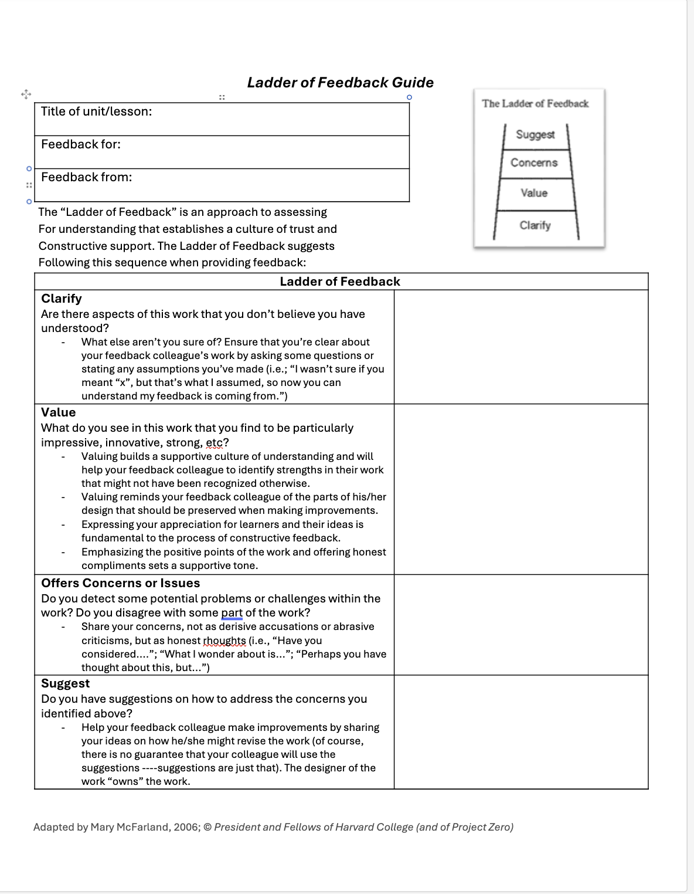

Resources
Notes:
Google Drive of ELA rubrics: https://drive.google.com/drive/folders/15Z16jgzsijvV30df_ZZGv3pmU4be5vzs?usp=drive_link
Ladder of Feedback Worksheet: https://docs.google.com/document/d/1tC2SSKH75SVxCSJSTwiI7AT4LZkbjOFq/edit?usp=sharing&ouid=109180241824415829820&rtpof=true&sd=true

Slide 24
NEXT UP:
Bring a FRIEND!
December 3: Student Self-Evaluation
February 4: Goal-setting
April 8: EOY Share-out/Lesson Sharing
Notes:
https://forms.zohopublic.com/cccs/form/ColoradoCTEStandardsIntegrationCommunityofPractice/formperma/eTET4i8AK7nZdN7x7-eI7L7mUC9sgNqC_DfFhygNPMA

Slide 25
Thanks for joining us!
Emily Fickbohm
Emily.fickbohm@cccs.edu
Jennifer Cormier
Jennifer.cormier@cccs.edu

