Slide 1

Academic Integration: Math
Emily Fickbohm, Director of CTE Accountability and Performance
Jennifer Cormier, Director of Program Quality
Erin Brewer, Integrated CTE Math Teacher, Cherry Creek School District

Slide 2
Where do students naturally use math in your CTE program?
Notes:
Highlight the importance of math integration in workforce readiness
Connection to program quality and student success
Overview of workshop outcomes

Slide 3
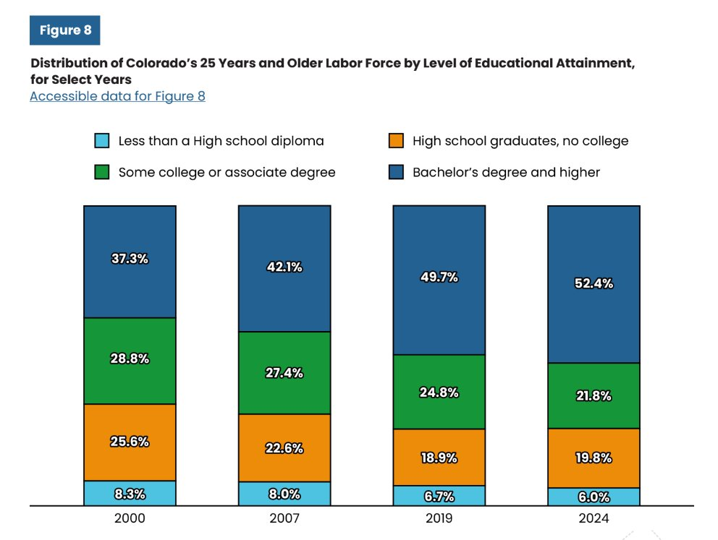
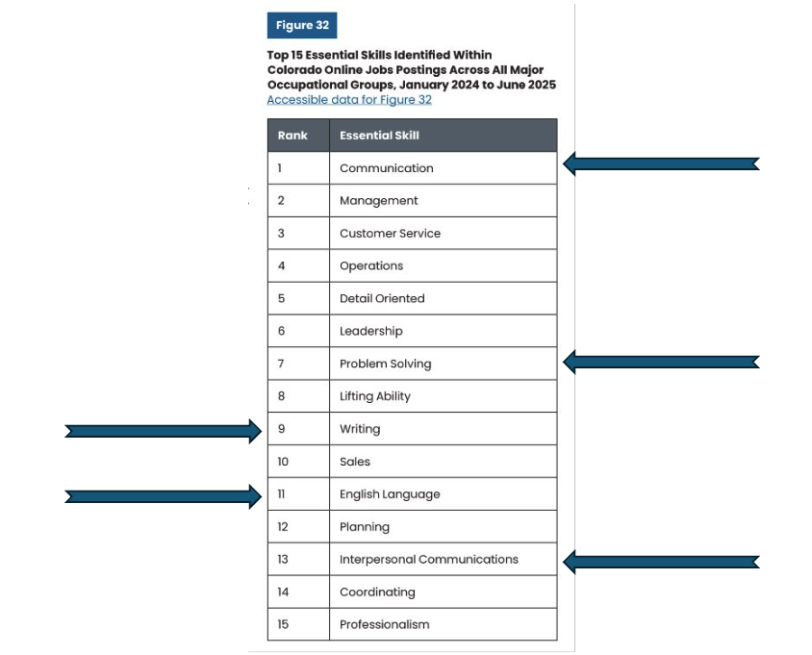
The Why?
AND.....It's a Perkins Performance Metric; 2S2: Academic Proficiency in Math.

Slide 4
Academic Alignment in Math
Define academic alignment in CTE
Identify math standards within technical skills
Outline the benefits of intentional math integration

Slide 5
Math Standards: Old or new or both?

Slide 6
Learning Targets vs. Success Criteria

Slide 7
Characteristics of Strong success critera

Slide 8
CTE Math Success Criteria Examples

Slide 9
Breakout/Work Time?

Slide 10
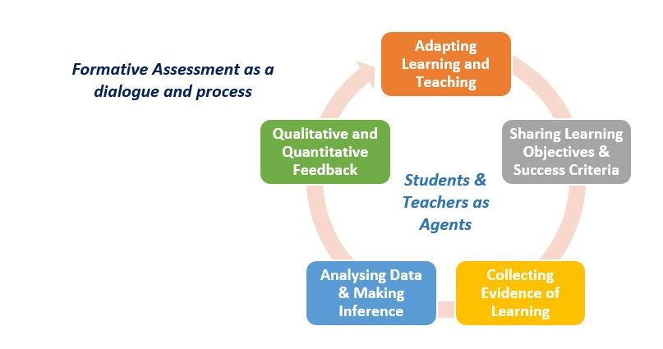
Formative Assessment
Learning Target
Success Criteria
Feedback Loops
Self-Assessments
Goal-Setting

Slide 11
Tying it all together....

Slide 12
Additional thoughts/shareout?

Slide 13
Questions
Insert contact information

