Slide 1


Slide 2
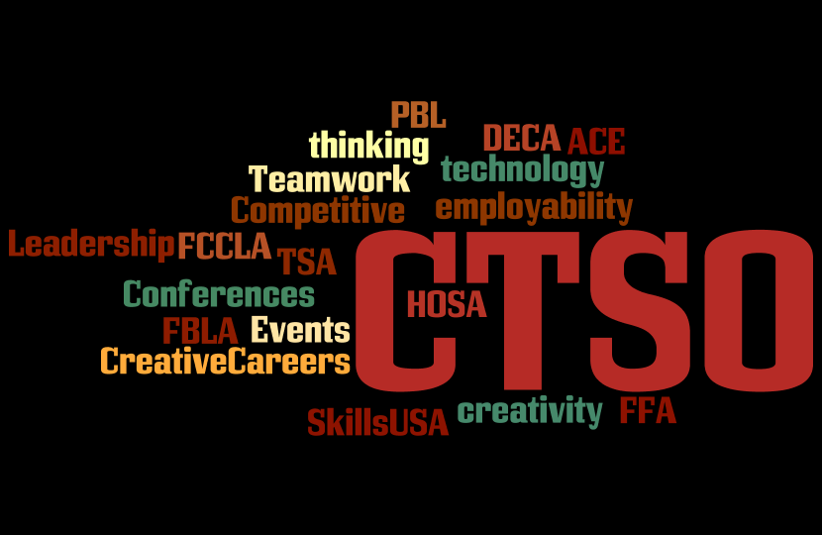
Notes:
Continuum Activity
Involvement in leadership in high school
Leadership Work
Work with Students
CTSO
Today, we will be discussing the purpose of CTSOs and a program of work

Slide 4
RULE
3.09 Colorado Career and Technical Student Organizations (CTSOs)
(Board Rule: CTA 3.1F; CRS: 23-8-103 (2d))
According to Board Rule each CTE program must provide leadership training opportunities by establishing and maintaining all appropriate CTE student leadership organizations as listed herein, or such other leadership organization as may be approved by the Board in special circumstances:

Slide 5
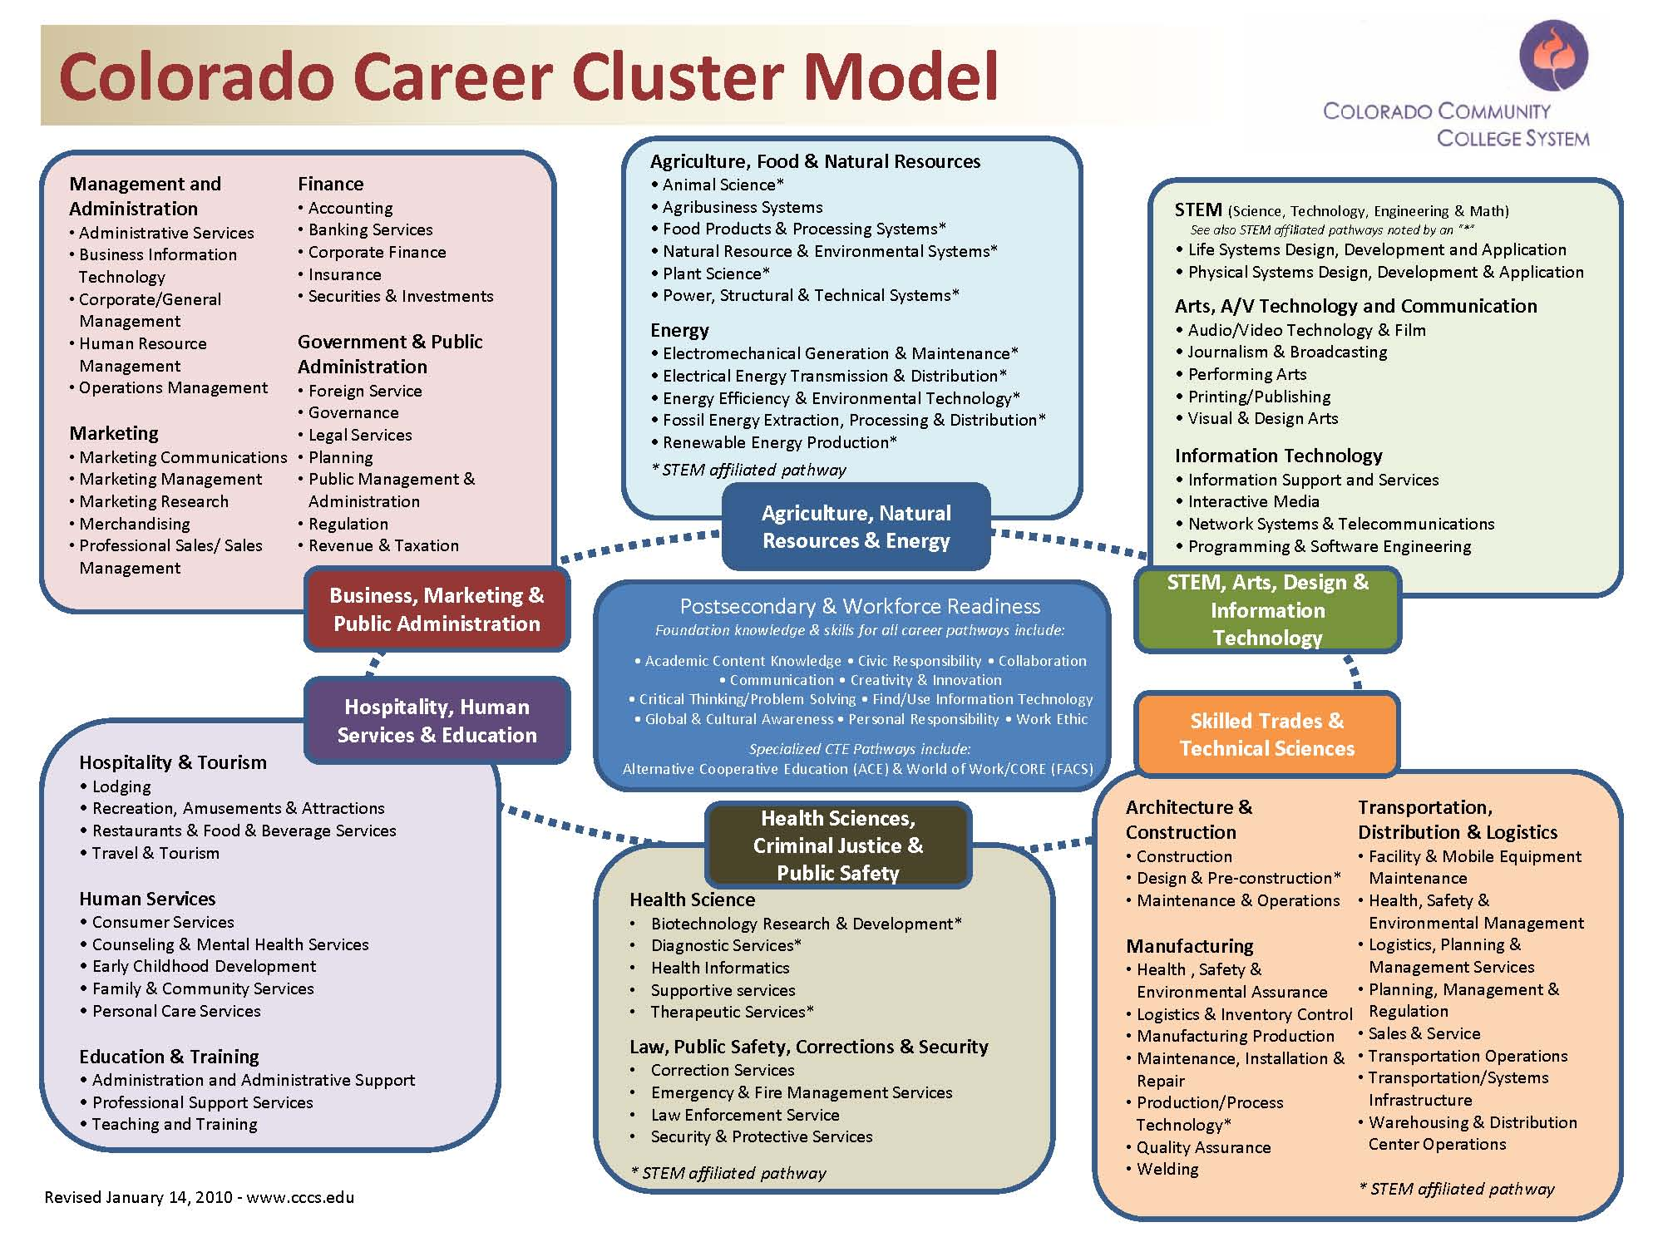








Agricultural & Natural Resources
Business & Public Administration
STEM, Arts, Design & Information Technology
Hospitality, Human Services & Education
Skilled Trades & Technical Sciences
Health Sciences & Public Safety
Notes:
5

Slide 6


Slide 7
Requirements
If a local CTSO is established and maintained but not state and nationally affiliated, it must have (and keep on file copies for the most recent year):
A constitution and/or set of bylaws, including how membership in the CTSO is determined. In order to be a viable CTSO, the organization must be available to ALL students participating in the program area.
A list of the current local membership
A list of current elected officers
Agendas & minutes of business meetings held by the organization for the current and prior year. At minimum the local CTSO will meet at least two times per term.
Documentation that the CTSO is co‐curricular. Evidence should include examples of how the CTSO activities and program of work is integrated into the daily curricular plan, i.e. class syllabus.
Documentation of a Program of Work: Programs are expected to carry out a program of work by using committees to plan and carry out activities.
This documentation may be as simple as a narrative describing the local chapter’s
involvement in their selected areas and may vary with the type of CTSO.

Slide 8

2012-13 Colorado ACE CTSO Handbook

Slide 9


Slide 10

ACE Student Leadership Conference
Competitive
Events
Workshops
Speaker
April 11th
CCCS Conference Center

Slide 11
ACE Competitive Events
Career Planning
Employment Dynamics: You’re the Boss
Employment Dynamics: Customer Service
Entrepreneurship
Event Planning
Interviewing
Job Application
Personal Finance
On ACE website

Slide 12

CTSO

