Slide 1


CLNA Regional Needs Assessment Kickoff - 2025

Slide 2
Colorado CTE Mission
CTE ensures a thriving Colorado economy by providing relevant and rigorous education that is connected, responsive and real.

Slide 3
The Strengthening Career and Technical Education (CTE) for the 21st Century Act (Perkins V), specifically states that “To be eligible to receive financial assistance under this part, an eligible recipient shall—(A) conduct a comprehensive local needs assessment related to career and technical education and include the results of the needs assessment in the local application submitted under subsection (a); and (B) not less than once every 2 years, update such comprehensive local needs assessment.”(Section 134(c)

Slide 4
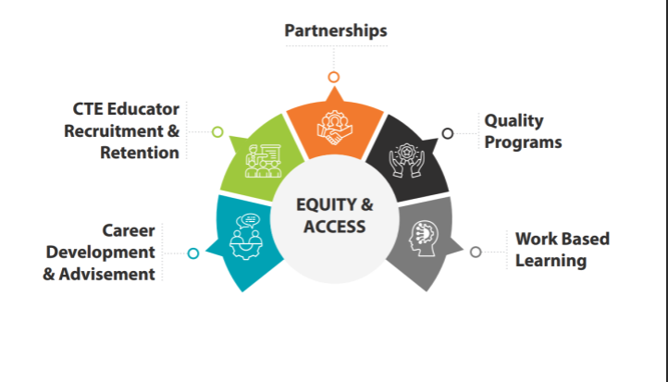
Colorado CTE Goals

Slide 5
CLNA – Key Dates
August – Kick Off
September to November – local/regional homework needed and assessment of progress goals
September to November – Regional meetings to connect to CLNA and consolidate local work
Late November - Finalize Signatures
December 1 – deadline to submit final CLNA to CCCS

Slide 6
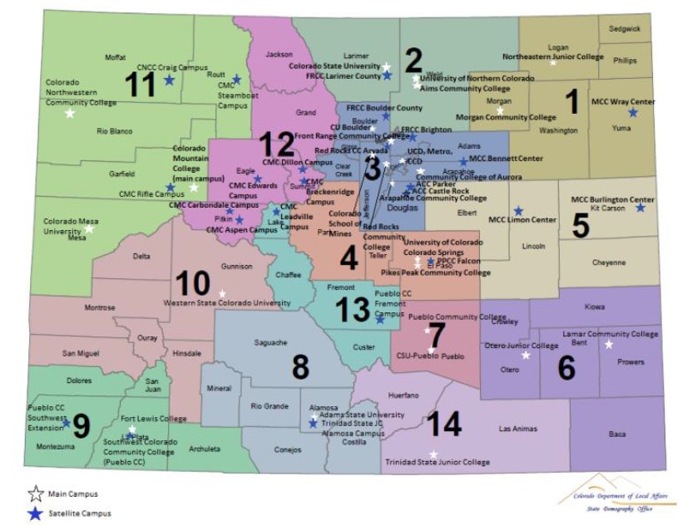

Slide 7
Regional Meeting Dates Fall 2025
September 22nd – Sterling @ NJC Click here to register for Sterling
Regions : 1 & 5
September 23rd – La Junta @ Otero Click here to register for La Junta
Regions: 6, 7, & 14
September 24th – Alamosa @ Adams State Click here to register for Alamosa
Regions: 8, 9, 10, 13
September 25th – Grand Junction @Co Mesa University Click here to register for Grand Junction
Regions: 10, 11, & 12
September 30th - Denver @ CCCS Click here to register for Denver
Regions: 2, 3, & 4

Slide 8
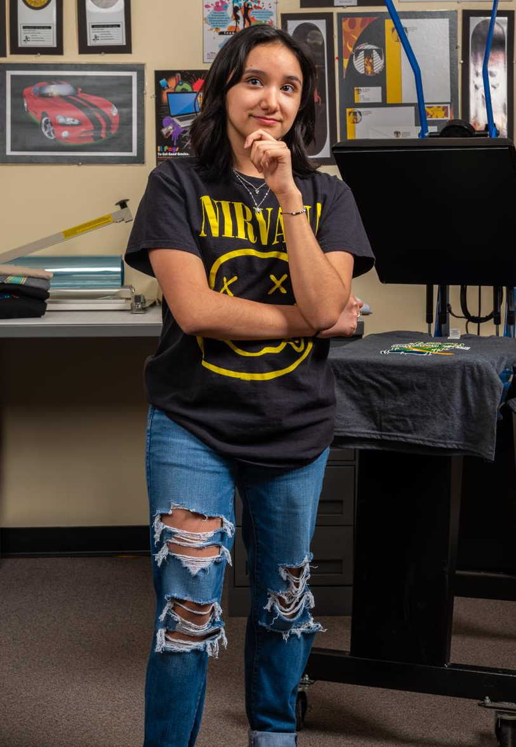
To-Do List to Prepare for the 2025 CLNA:
Engage each entity in your region to begin coordination process.
Identify an individual or team that will coordinate the communication & any additional meetings.
Sign up to attend one of the regional meetings.
Begin gathering relevant stakeholder feedback and reviewing local level documentation, data, and any homework determined in your region in preparation for the fall regional meeting.

Slide 9
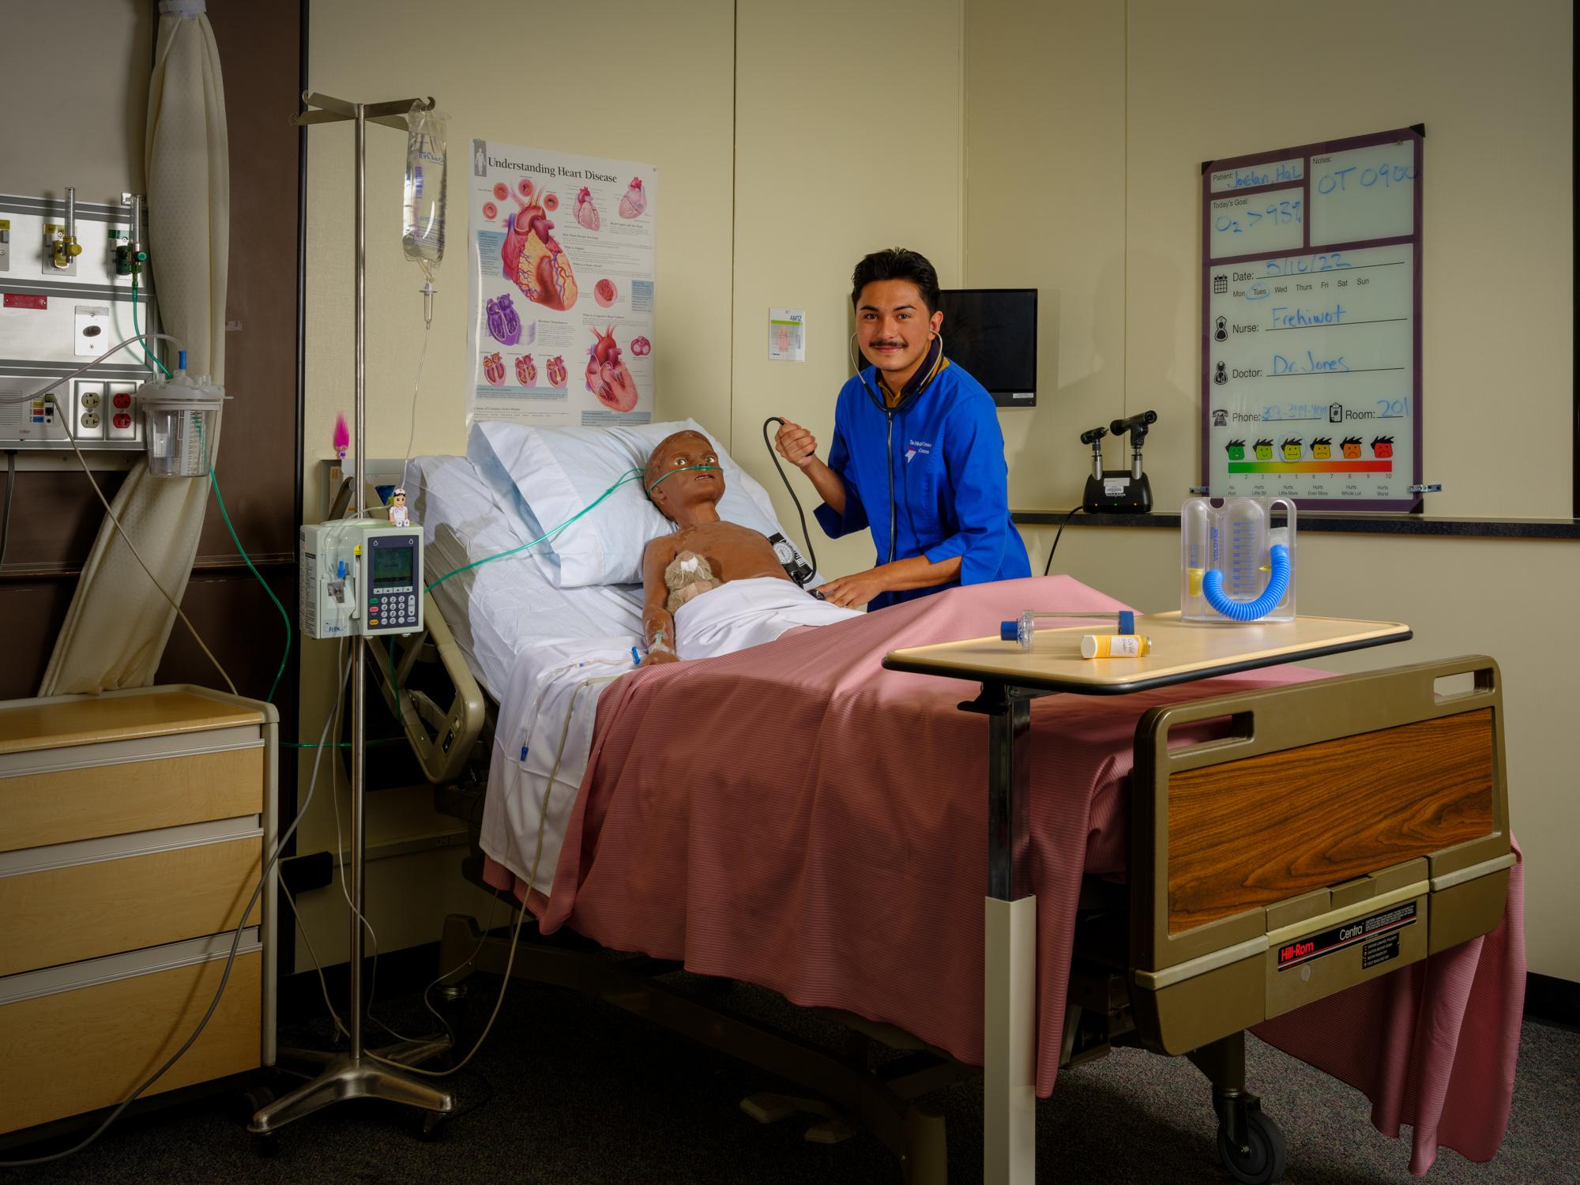
Resources:
Supplemental Worksheet
CLNA Handbook
Resource Guide
List of Regional Assignments and Contacts
Grant Funded Project Alignment Worksheet to Assess Alignment to Priorities
CCCS offered 1:1 sessions to review CTA data, gaps, opportunities, etc.
Customized support as requested.

Slide 10
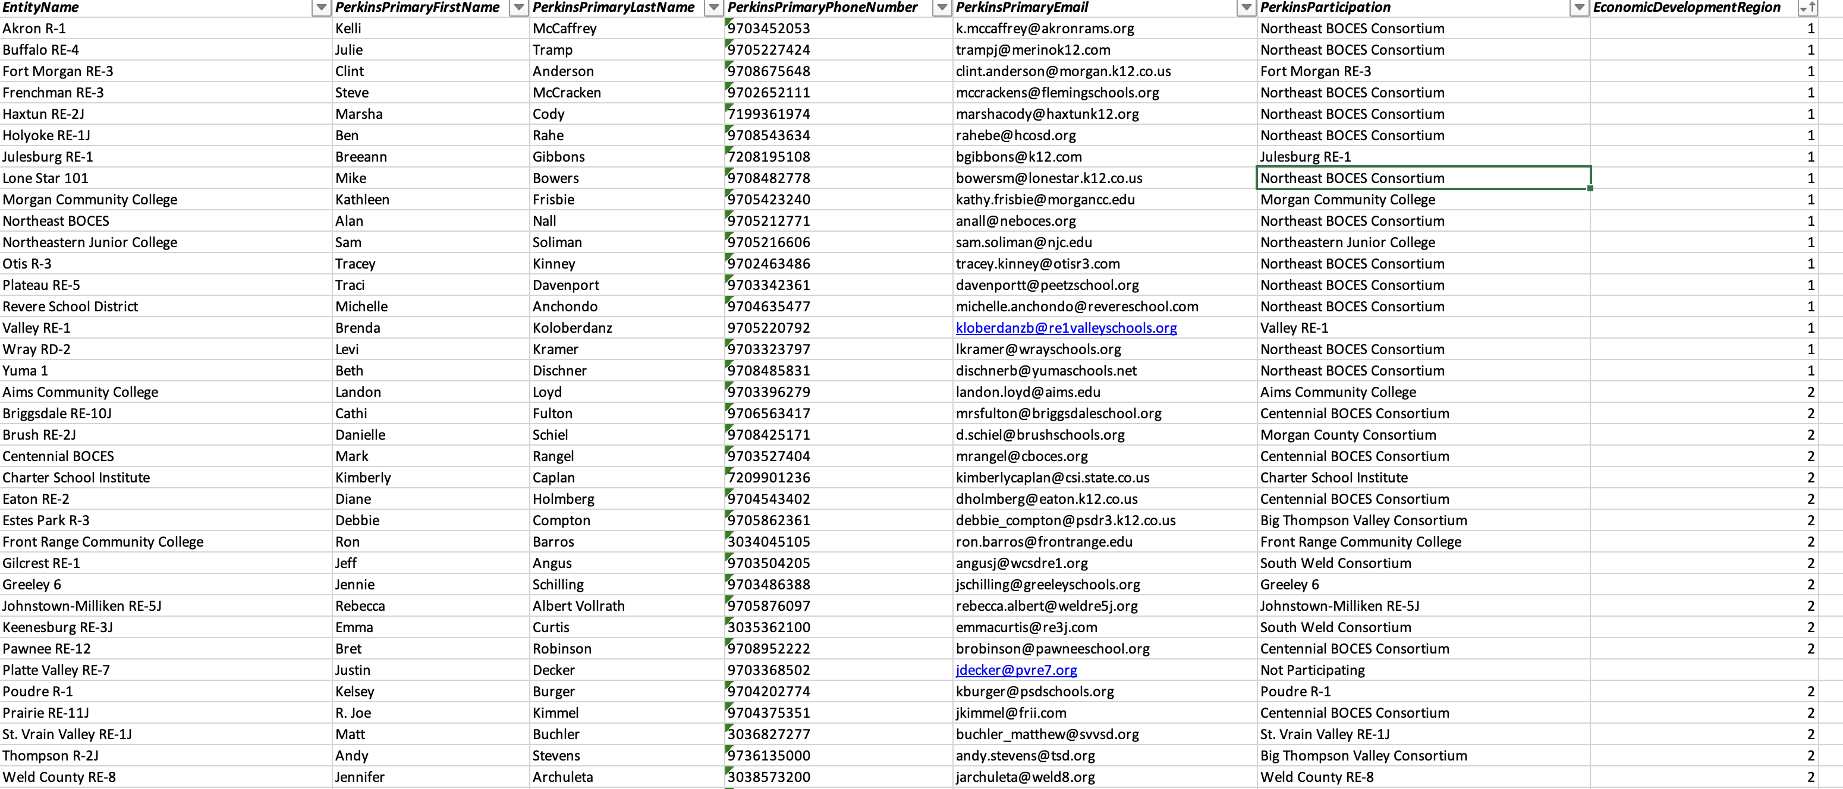
List of Region Assignments & Contacts
http://coloradostateplan.com/administrator/perkins/perkins-forms-and-files/

Slide 11
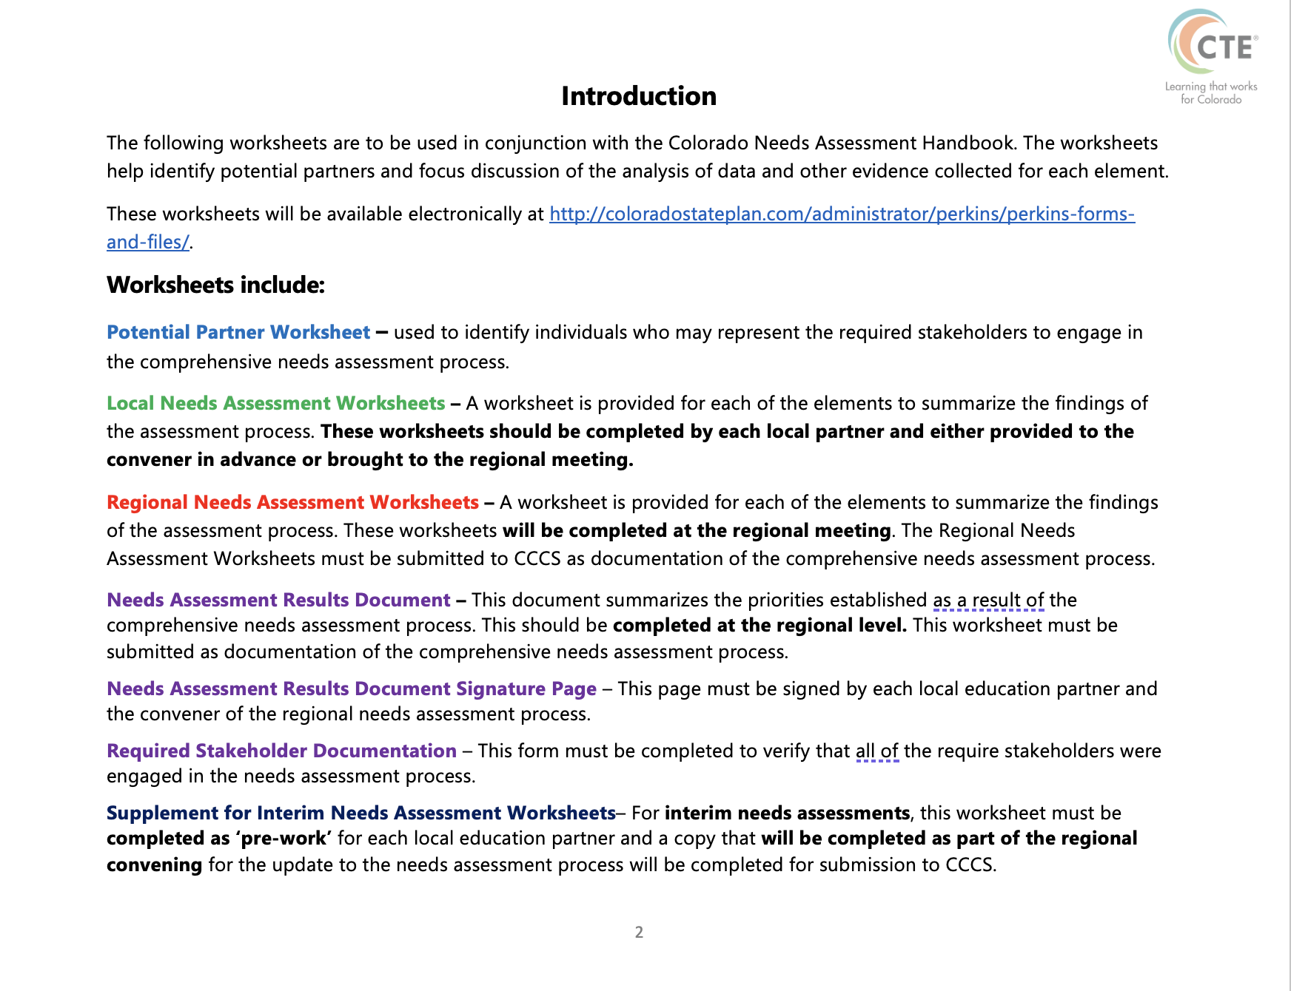
Regional Meeting
Homework

Slide 12
Stakeholders to Engage – Keep Evidence
Secondary and Postsecondary CTE Faculty
Secondary and Post-secondary Career Counselors, Advising Professionals, and Academic Counselors.
Secondary Instructional Support, Paraprofessionals
Secondary and Postsecondary Administrators
Representatives of Special Populations – Gender, race, ethnicity, migrant status, disability, economically disadvantaged, nontraditional, single parent, pregnant women, out of work individuals, English learners, homeless, foster care, active-duty military parents, *corrections
Local Workforce Development Board Members
Regional Economic Development Members
Local Business and Industry
Students and Parents
Representative of Tribal Organizations
Other Relevant Stakeholders

Slide 13
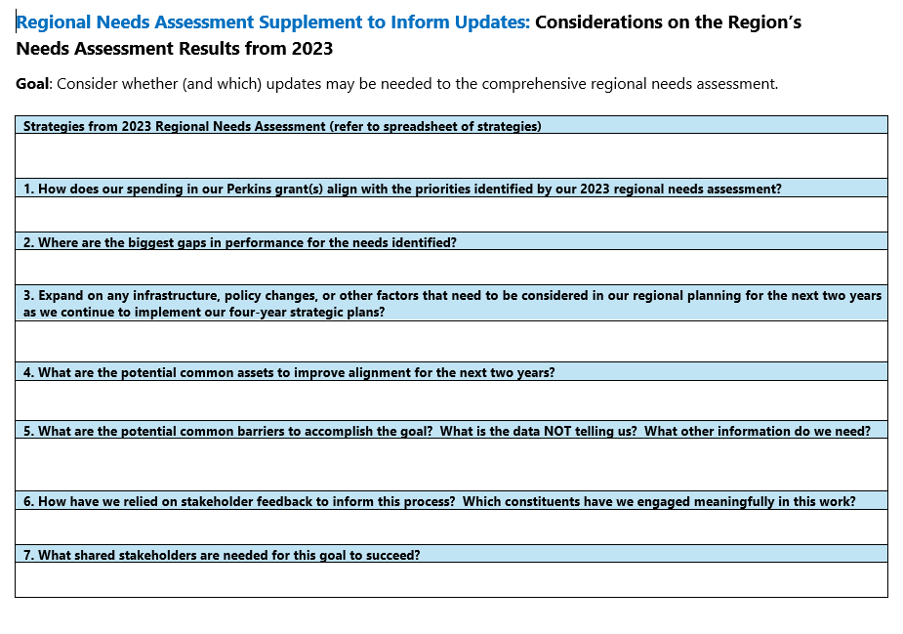

Slide 14
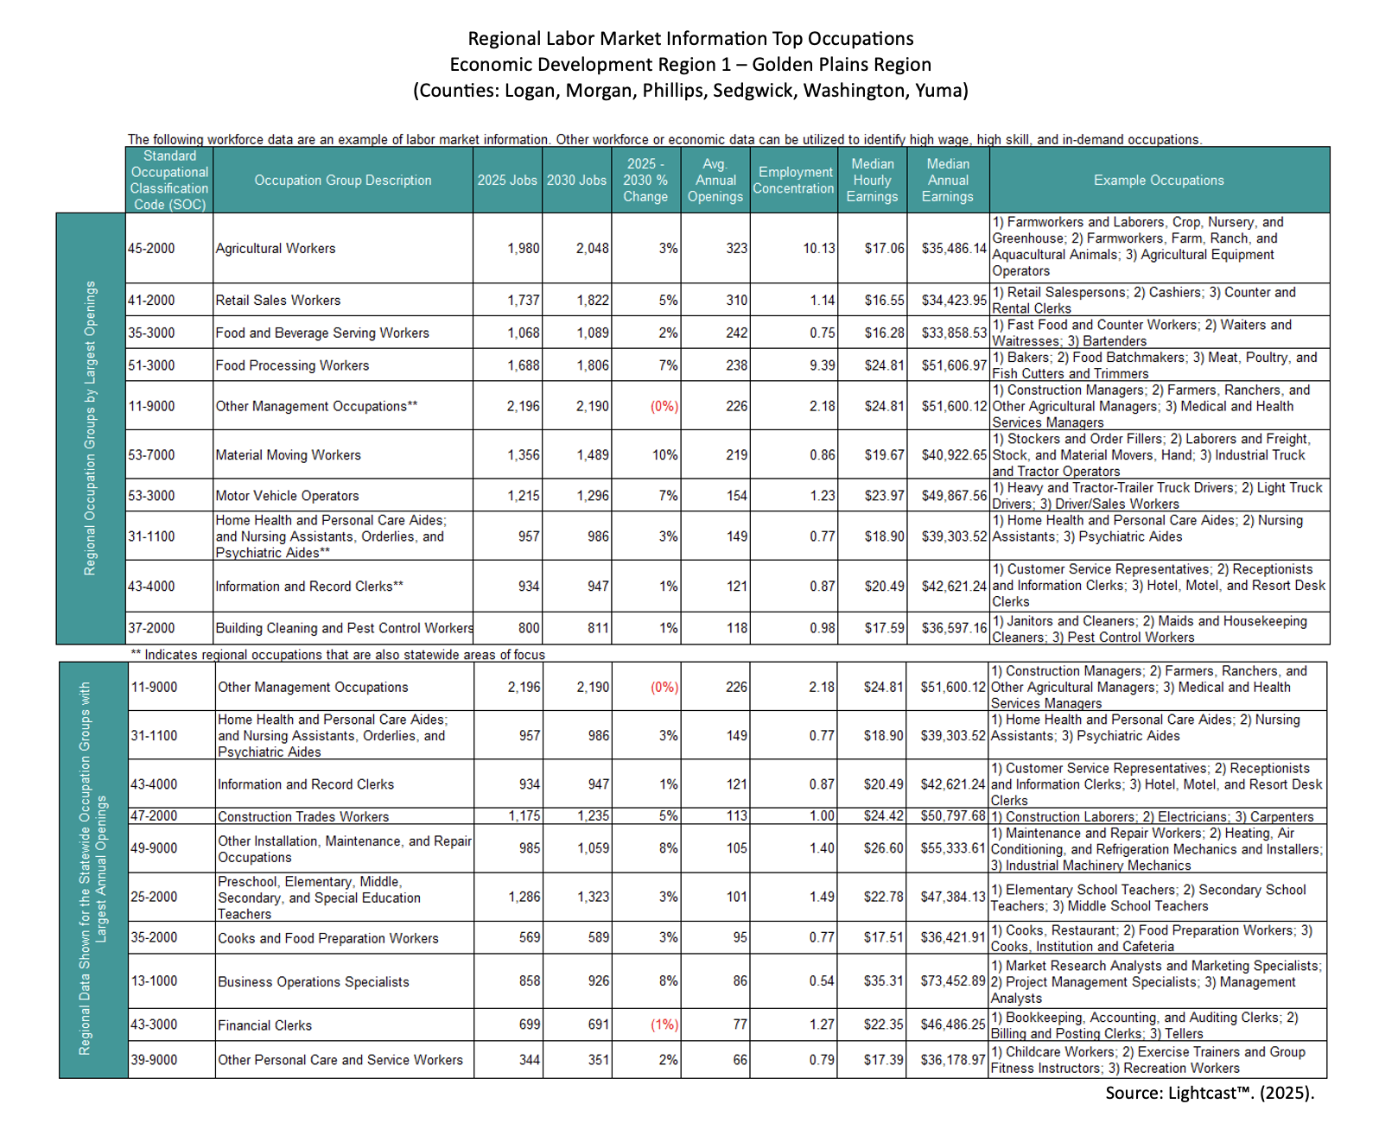

Slide 15
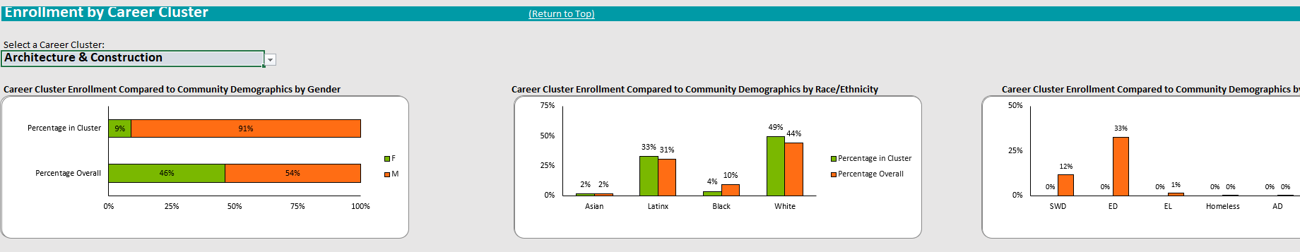
Data Dashboards

Slide 16
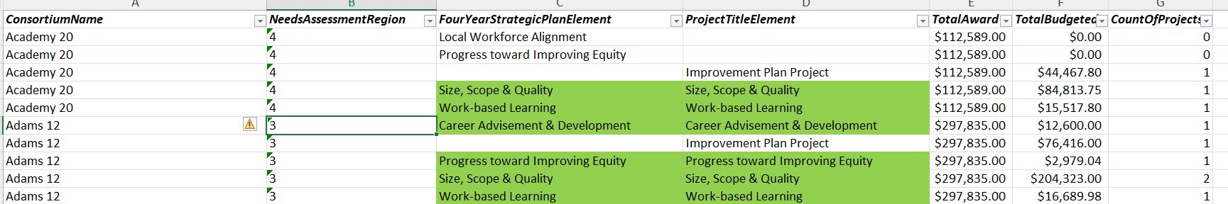
Spending Alignment to Priorities
Loom Video Link Explanation (2 min)

Slide 17
Next Steps
Sign up for a regional meeting if you’re available (or make sure someone from your district/college is).
Connect with your stakeholder groups
    - Connect with your region to consolidate “asks” of shared stakeholder groups like business and industry, economic development partners, community organizations, etc.
Do your local “homework” aka the grey supplemental worksheet on the back page of the CLNA worksheet packet.
Come to the regional meeting.

Slide 18
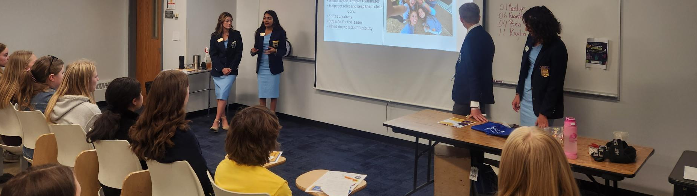
Regional Meeting Details
Each day is schedule from 9:00am to 4:00pm
Register as soon as you can – Deadline is August 29th
Light breakfast, beverages, and lunch provided.
Bring a device and completed local ”homework” in advance.

Slide 19


