Slide 1
CTE Regional Needs Assessment Kick-Off
August 2023
Notes:
Colorado’s strategic plan will serve secondary and post secondary learners in their preparation for meaningful careers.
The Colorado CTE Strategic Plan will lead the state’s efforts forward over the next 5 years and will:
Highlight opportunities to engage stakeholders
Establish clear and consistent goals for the education and workforce systems
Provide the platform to communicate Colorado’s CTE vision publicly
The strategic plan development was a collaborative process with partners and stakeholders from a variety of experiences and perspectives. Participants included:
Secondary education
Postsecondary education
Workforce development
Individual businesses
Industry associations
Philanthropic organizations
Parents
Learners

Slide 2
Colorado CTE Mission
CTE ensures a thriving Colorado economy by providing relevant and rigorous education that is connected, responsive and real.
Notes:
Focus in this CLNA process on ‘connected’, responsive and real.
The CTE system is more than CTE classroom programs or individual CTE classes. The CTE system is a network of education and workforce partners. These partners include but are not limited to:
Business and Industry
Community-Based Organizations
Economic Development
Postsecondary Education
Secondary Education
Workforce Development

Slide 3
The Strengthening Career and Technical Education (CTE) for the 21st Century Act (Perkins V), specifically states that “To be eligible to receive financial assistance under this part, an eligible recipient shall—(A) conduct a comprehensive local needs assessment related to career and technical education and include the results of the needs assessment in the local application submitted under subsection (a); and (B) not less than once every 2 years, update such comprehensive local needs assessment.”(Section 134(c))

Slide 4
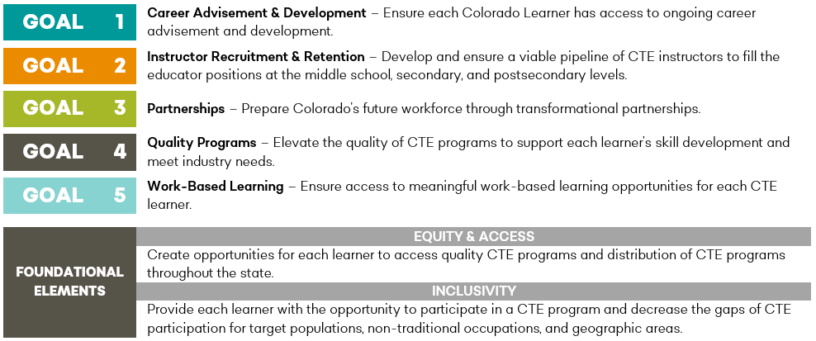
Colorado CTE Goals
Notes:
Focus on partnership and equity and making data-driven decisions that can help improve our CTE programs…here to present more is Greg McBoat from Adams County Workforce Center to talk about some of the work they’re doing in partnership with school districts in their region and resources that are available through WF partners.
Goals in this Strategic Plan have been identified and addressed separately, however there is the expectation that strategies and key indicators within each goal can and should impact other goals.
The identified goals are inclusive and should involve all relevant partners, stakeholders, and information pertinent to Colorado’s education and workforce systems.
The Goals in the CTE Strategic Plan are designed to be:
Universal – can be applied to CTE systems in a school, district, or at a regional level.
Adaptable – can be modified to accommodate individual partners or regions.
Broad – in many instances will overlap with other local, regional, and state priorities and initiatives.
There are themes or elements throughout the CTE Strategic Plan that apply to all goals. These themes can:
Guide the work related to the Goals
Provide a place for Partners to identify themselves and their role in the CTE system

Slide 5
CLNA – Key Dates
August 31– Kickoff webinar
September to November – local/regional homework as needed and assessment of progress toward goals
September to November - Regional Meetings to connect on CLNA and consolidate local work
Late November – Finalize signatures
December 1 deadline to submit final CLNA to CCCS
Notes:
CLNA done this fall to help support planning that will start in spring for Perkins grant activities for FY24 and FY25

Slide 6
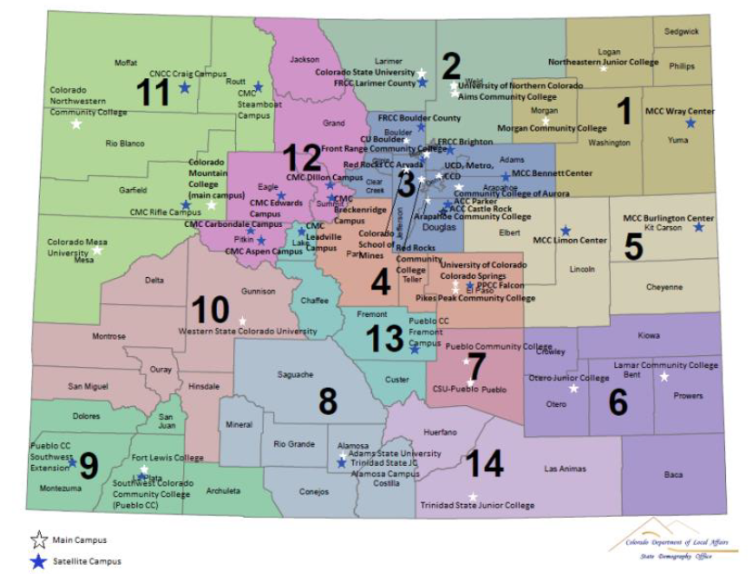
Notes:
These are the regions – same as last time.

Slide 7
Regional Meeting Dates Fall 2023
Sept 25 – Sterling (NJC) – Click here to register for Sterling!
Sept 26 – La Junta (Otero) – Click here to register for La Junta!
Sept 27 – Alamosa (Trinidad State) – Click here to register for Alamosa!
Sept 28 – Durango (La Plata County Fairgrounds) – Click here to register for Durango!
Oct 5 – Grand Junction (CSU Western Campus) – Click here to register for Grand Junction!
Oct 6 – Montrose (District Office Board Room) – Click here to register for Montrose!
Nov 9 – Colorado Springs (Tesla Center – D11) – Click here to register for Colorado Springs!
Nov 13 – Pueblo (PCC) – Click here to register for Pueblo!
Nov 16 – Denver (Adams 12) –Click here to register for Denver!
Nov 17 – Ft. Collins (Event Center at Foothills Mall) – Click here to register for Ft. Collins!

Slide 8
To-Do List to Prepare for the 2023 CLNA:
Engage each entity in your region to begin coordination process.
Identify an individual or team that will coordinate the communication & any additional meetings.
Sign up to attend one of the regional meetings.
Begin gathering relevant stakeholder feedback and reviewing local level documentation, data, and any homework determined in your region in preparation for a fall regional meeting.

Slide 9
Resources
Worksheets
CLNA Handbook
Resource Guide
List of Regional Assignments and Contacts
Grant Funded Project Alignment Worksheet to Assess Alignment to Priorities
CCCS offered 1:1 sessions to review CTA data, gaps, opportunities, etc.
Customized supports as requested (cte@cccs.edu)

Slide 10
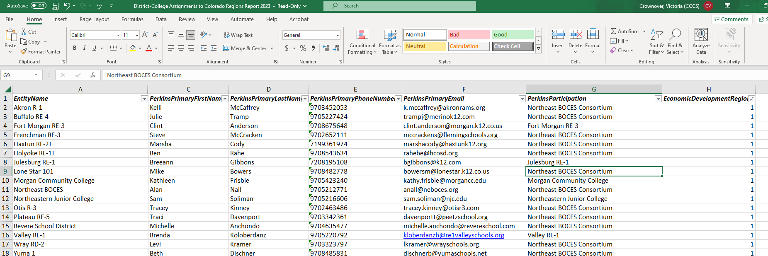
List of Region Assignments & Contacts
http://coloradostateplan.com/administrator/perkins/perkins-forms-and-files/

Slide 11
Homework
Regional Meeting

Slide 12
Stakeholders to Engage – Keep Evidence
Secondary and Postsecondary CTE Faculty
Secondary and Postsecondary Career Counselors, Adivising Professionals and Academic Counselors
Secondary Instructional Support, Paraprofesssionals
Secondary and Postsecondary Administrators
Representatives of Special Populations - Gender, race, ethnicity, migrant status, disability, economically disadvantaged, nontraditional, single parent, pregnant women, out of work individuals, English learners, homeless, foster care, active duty military parents, *corrections
Local Workforce Development Board Members
Regional Economic Development Member
Local Business and Industry
Students and Parents
Representatives of Tribal Organizations
Other Relevant Stakeholders

Slide 13
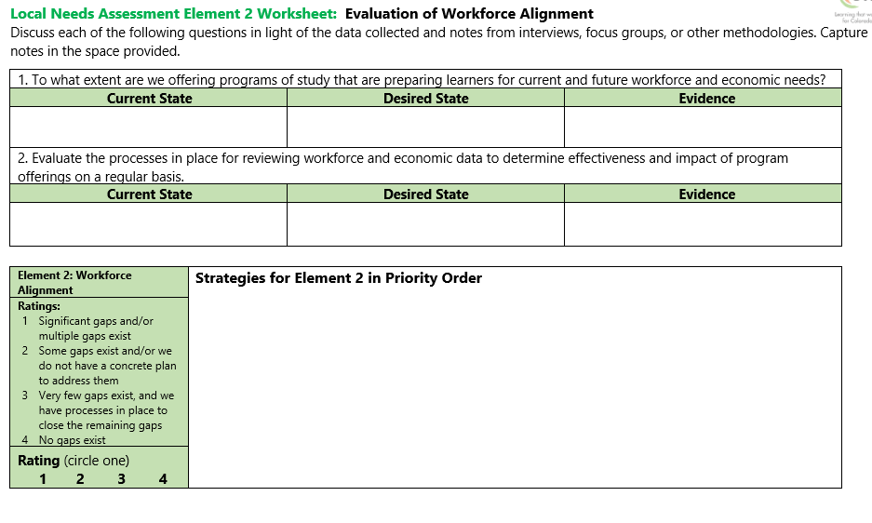

Slide 14
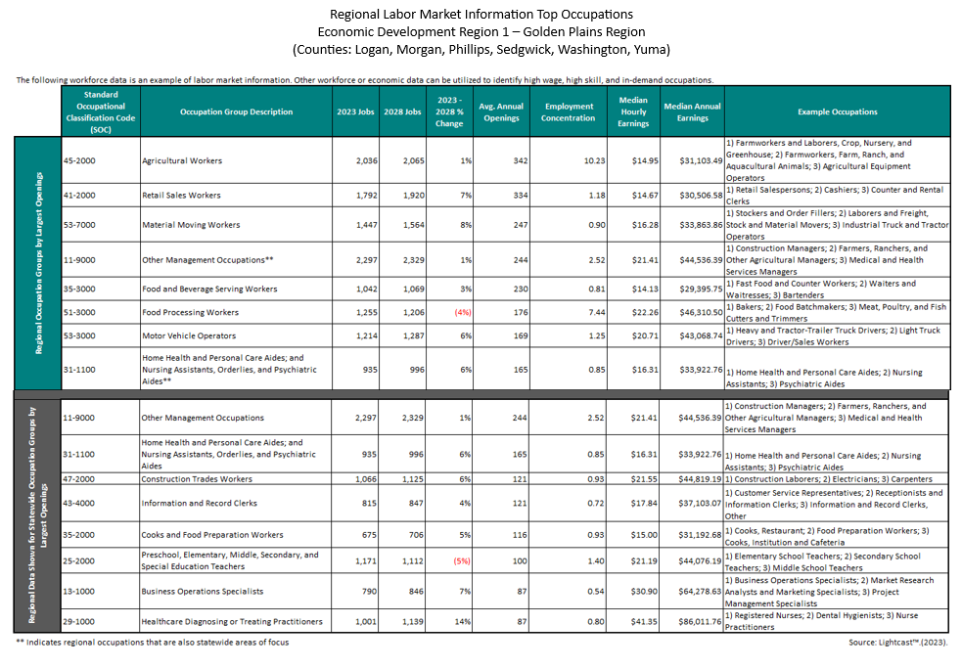

Slide 15
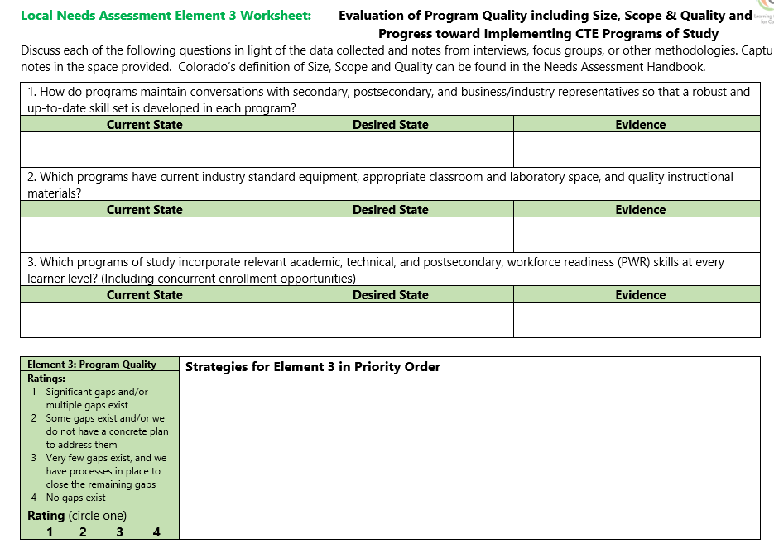

Slide 16
Data Dashboards – Student Data

Slide 17
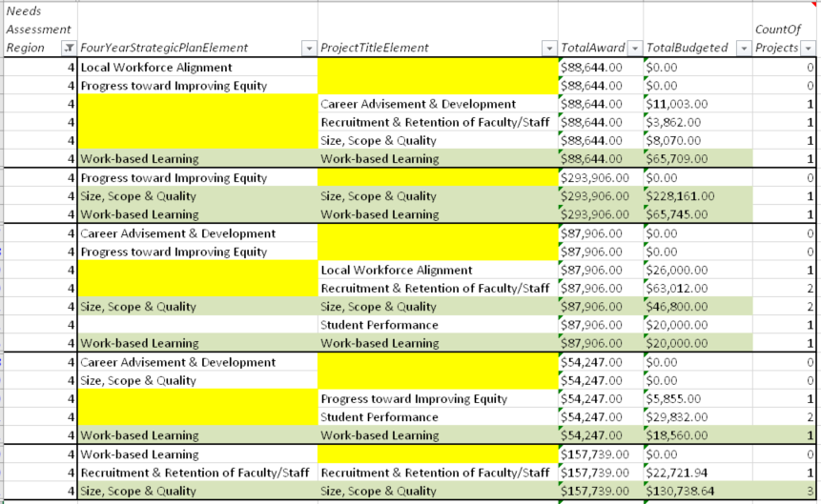
Spending Alignment to Priorities

Slide 18
Next Steps
Sign up for a regional meeting if you’re available (or make sure someone from your district/college is)
Connect with your stakeholder groups
Connect with your region to consolidate “asks” of shared stakeholder groups like business and industry, economic development partners, community organizations, etc.
Do your local “homework” aka the green sheets in the first segment of the CLNA worksheet packet
Come to a regional meeting

Slide 19
Regional Meetings Details
Each day is scheduled from 9:00 A.M. to 4:30 P.M.
Register as soon as you can - Deadline September 18
Note if any lunch accommodations
Light breakfast, beverages, and lunch provided
Bring a Device and completed local “homework” in advance

